Slide 1
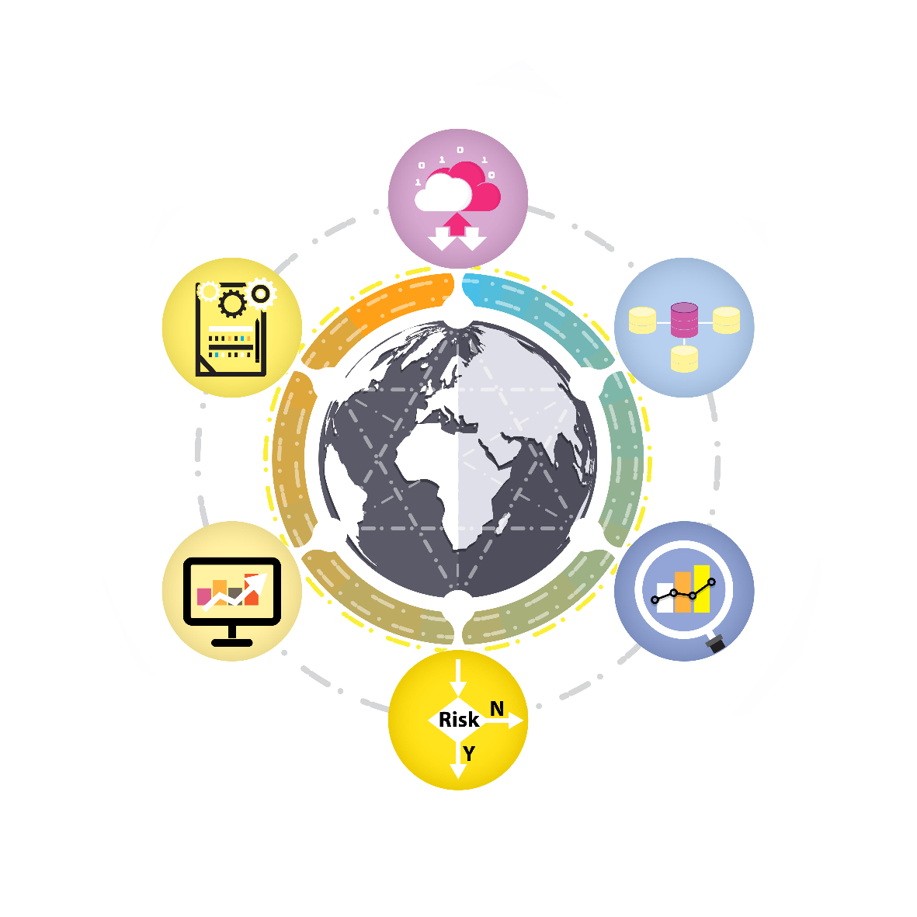
Big Data and Analytics
Architecture Patterns and Standards Playbook
Next Gen Architecture Program

Slide 2
Big data and analytics – architecture patterns and practice: table of contents
01
Big Data & Analytics Trends
Purpose of reference architecture
Current and emerging Big Data & Analytics Trends
Big Data & Analytics architecture components
Non functional requirements
Architecture principles
Reference architecture and capabilities
Architectural patterns
Vendor specific architectures
AWS
Azure
GCP
Industry solutions (WIP)
02
03
04

Slide 3
Big Data and Analytics Patterns
Current and emerging big data and analytics trends

Slide 4
How to use this playbook
Overview: Deloitte’s Big Data and Analytics: Patterns and Standards document is a reference artifact for Architects and Technical staff. The document could be used in the project scoping and architecture definition phase to define a standards’ based Architecture Blueprint for a Big Data or Cloud Analytics project.
Document contents: The document contains definition of capabilities and Principles and Patterns of design that can be leveraged for the future state architecture. The document also contains vendor specific reference architecture for Big Data and Analytics workloads and commonly used components.
Technical components: This document also serves as a library of Deloitte’s reusable technical components and common data services implemented across projects.
As used in this document, “Deloitte” means Deloitte Consulting LLP, a subsidiary of Deloitte LLP. Please see www.deloitte.com/us/about for a detailed description of the legal structure of Deloitte USA LLP, Deloitte LLP and their
respective subsidiaries. Certain services may not be available to attest clients under the rules and regulations of public accounting.

Slide 5
Emerging big data and analytics trends
Augmented analytics
Demand for complete and meaningful insights embedded in the business processes to drive business decisions will grow. This will lead to transformative technologies, such as data science, machine learning and artificial intelligence (AI) embedded in the business systems
Real time systems
The business will drive need to respond to business events in real time, necessitating development of Real Time Systems using streaming data
Data as a Service (DaaS)
DaaS as a standard service layer to provide access to organizational data spread across disparate data sources will be a standard way to consume data
Cloud native big data computing
Cloud native application pose Data Integration challenges between On-Premise and Cloud as well as pose data security, network security and cost management challenges
Multiple cloud platforms and scale
Organizations will adopt multiple cloud platforms as a strategy to avoid vendor lock-in, improve reliability and performance optimizations
DataOps
DataOps is combination of Agile, DevOps and Lean Manufacturing process to speed the value realization of data projects. DataOps is an important component of data transformation projects

Slide 6
Architecture description
Non functional requirements

Slide 7
Architecture building blocks
Document the architecture: A well thought out architecture helps to build a robust data and analytics system which meets the stakeholder’s concerns, business requirements and business goals. A well documented architecture drives the decisions across the development lifecycle. This section provides a set of non-functional requirements and enterprise and application principles to drive the scope of architecture work for a system.
Scope the effort: In the scoping phase of the project, identify architecture stakeholders, capture their concerns, and significant business requirements that impact the architecture. It should confirm and elaborate business goals, business drivers, and constraints that drive the architectural tradeoffs, and which have significant implications on the architecture.
Perform following steps (in any order) to capture the architecture scope of work.
Define functional requirements: Define the non-functional requirements, understand the different types of workloads
Document architectural principles: Document the Enterprise and Architecture principles based on the discussions with stakeholders and architects. E.g., Disaster Recovery is not required for Tier 3 applications (applications which are classified as non-mission critical)
Validate stakeholder alignment on scope: Agree with the key stakeholders on the system boundaries and Architecture scope before embarking on the design of subsystems
Validate conceptual architecture: Use the reference conceptual architecture to arrive at the architecture capabilities required for the program
Identify gaps: If current architecture exists then identify gaps between current and target state conceptual architecture
Define technical architecture: Create Technical Architecture and create views and drive viewpoints for significant architecture requirements (e.g. Security, Auditing etc.). These views are tailored for various audiences.

Slide 8
Examples of non–functional requirements
# | Category | Description
NFR 1 | Workloads | System must be able to support mixed workloads that includes Ad-hoc request, System to System Extracts, User Reports, Dynamic Dashboards, Data Science and Data processing pipeline
NFR 2 | Metadata | System must provide robust mechanism to capture all required metadata, store it on a standardized repository utilized by business and other users
NFR 3 | Availability | System must support user workloads across geographies and it needs to be available even during data processing windows
NFR 4 | Security | System must be secured with role based data entitlements (RBAC) attribute based access control (ABAC) based on Enterprise Data Governance and security profiles
NFR 5 | Scalability | System must be horizontally and vertically scalable to support the data growth and computing power demand
NFR 6 | History | System must retain history data on premise as per business needs, in a format that can be used for reporting and other needs
NFR 7 | Data Movement | Solution must reduce data hops to consumption layer and maintain data integrity during data processing and movement
NFR 8 | Latency/Data Refresh Frequency | System should be able to batch process the data multiple times a day with minimal hops. Support of interactive queries with a reasonable response time is important
NFR 9 | Disaster Recovery | System must provide DR capability for RPO (Recovery Point Objective) of ‘x’ hours & RTO (Recovery Time Objective) of ‘y’ hours
NFR 10 | Character Encoding & Language Support | System must support data in the UTF-8 character set and all reporting must be available in the English language

Slide 9
List of non–functional requirements (cont.)
# | Category | Description
NFR 11 | Multi Tenancy | System must be able to provide data isolation for multiple tenants/applications as per tenants/business need
NFR 12 | Audit & Data Quality | System must maintain data lineage and provide audit, DQ reports. DQ remediations should be done at source
NFR 13 | Provisioning | Data provisioning/accessing must be done on the curated data or a RAW data layer. Reports should be scheduled and delivered via email or portal
NFR 14 | Op Support/Monitoring | System must provide capability to monitor jobs runs and failures. System must provide ability to recover jobs within defined service level agreements (SLA).
NFR 15 | Encryption & Sensitive Data | System must provide capability to encrypt/decrypt sensitive data (PHI/PCI)
NFR 16 | Archival & Backup | System must provide capability to archive the input source data and maintain a rolling month backup at any given time
NFR 16 | Devops | System must use standardized Devops process for faster development and deployment
NFR 17 | Regulatory/Sox Compliance | System should be able to provide traceability from source to target (audit) for key data entities
NFR 18 | Interfaces | System should have ability to provide system to system extracts through governed zones (only through on-premise)
NFR 19 | Data Masking | System must provide capability to mask PII and other sensitive data stored in the cloud. PCI data must be encrypted before storing in any persistent repository.

Slide 10
Architecture description
Architecture principles

Slide 11
Application principles
 | 1. Re-use rather than duplicate capabilities | 2. Aim for cohesive functionality and avoid functional redundancy
Rational | The most effective way of providing a solution is though re-use of an existing capability wherever possible. Duplication is costly and adds uncertainty at all levels of the organization. | System functionality should be highly-cohesive, that is: each system or grouping of systems should contain only closely related functionality—it should do one thing only and do that thing well. Functional redundancy (unused/unwanted capabilities can cause loss of data integrity and increase maintenance costs related to the redundant capabilities.
Implications | Develop enterprise system standards: The accuracy and completeness of enterprise-wide systems should be maintained. Eliminate redundant systems: Business teams should not be allowed to develop local capabilities that are similar to or duplicate an enterprise-wide capability Standardize enterprise-based data management: The burden of data storage, processing and having a broader functional reach should be borne by enterprise systems. Provide governance for key information: Information, definitions and processes used to support enterprise decision-making should be standardized | Define function domains: Systems must be located in proper functional domains, with explicit governance established for the domains. Apply governance to functionality: Functionality requests should be submitted via governance process for the appropriate domain Standardize packages: Standard packages will be used for standard functionality Avoid turnkey solutions: All-in-one solutions combining unrelated sets of functionality should be avoided Remove redundant systems: Where functional redundancy is identified in a product or system, the functionality should (where possible) be removed or disabled.

Slide 12
Application principles (cont.)
 | 3. Low coupling between systems but ensure interoperability
Rational | Systems should have as few dependencies as possible between them (low-coupling). ‘High-coupling’ leads to an unmanageable number of interfaces with changes in one area causing widespread changes elsewhere. Software and hardware should conform to defined standards that promote interoperability for data, applications, and technology.
Implications | Use standards for interoperability: Interoperability standards and industry standards should be followed unless there is a compelling business reason to implement a non-standard solution. Define a process for standardization: A process for setting standards, reviewing and revising them periodically, and granting exceptions must be established. Prioritize end-to-end automation: All technology solutions will seek to automate and integrate seamlessly end-to-end processes as far as possible. Generalize services: Services (corporate APIs, for example) should be designed with no affinity to a specific service consumer, to promote re-use and reducing vendor lock-in. Provide local exception handling: Exception handling, and treatment should be managed by individual systems and should not span system boundaries. Standardize integration patterns: Where systems are to be integrated, pre-existing integrations patterns should be used where possible. Bespoke integrations should be by exception only.

Slide 13
Information principles
 | 4. Data management optimized for efficiency and reuse
Rational | Enterprise data systems should be managed efficiently to support processing a variety of datasets using standardized tools and policies and procedures, to reduce cost and duplication of effort and data. Data should be sourced directly from authoritative systems of record. The history and lineage of that data should be maintained in the enterprise data systems to ensure a common and accurate view of data over time.
Implications | System agility: Enterprise data systems should provide agility to accept diverse datasets at varying speeds Prioritize data and reporting: Data and reporting systems should be identified and prioritized based on consumption needs One source of record: Data should be sourced only from the System of Record for all domains of data Common integration tools and standards: Data should be ingested using enterprise level integration tools and standards Common data storage design: Data should be stored at the appropriate granularity for a consistent/immutable view of core facts and then aggregated as needed Minimize data duplication: There should be an effort minimize data duplication, and redundancy of systems Data lineage and history: Transactional and master/reference data history should be managed for rolling N years Centralize audit in system of record: Assume Audit and Retention regulatory requirements will be addressed by System Of Record

Slide 14
Information principles (cont.)
 | 5. Data standardization and governance to ensure consistency and accuracy
Rational | Enterprise data systems should have common standards for modeling so that data will be understood in a common business context, and data quality issues can be addressed. The lineage and Lifecyle of data should be managed to ensure that data is accurate and up-to-date. This management needs to be by members of the organization who understand and have a stake in the data and its quality.
Implications | Standard data models: Standardize and conform data to enterprise Data Model standards Standard business semantics: Use standardized business terms and logical data model definitions, and provide central documentation. Common MetaData: Capture and maintain metadata at all points through the data lifecycle Data stewardship: Enforce certification/validation of data through data stewardship processes, with clear ownership of data systems and processes Monitoring and logging: Enforce data health monitoring processes to ensure accuracy, completeness, consistency Health and audit reporting: Report data health monitoring using enterprise monitoring tools & guidelines. Provide ongoing DQ reports and dashboards in an automated fashion. Data profiling and DQ: Profile data prior to integration with enterprise data to identify anomalies

Slide 15
Information principles (cont.)
 | 6. Common vocabulary and data definitions
Rational | Data must have a common definition standard(s) with varying degrees of detail to enable sharing of data throughout the organization. A common vocabulary (aligned wherever possible with industry standards) facilitates effective communication and is also required to enable systems to exchange data.
Implications | Provide common vocabulary and business ownership: A common vocabulary must be established and used throughout the organization where definitions are understandable and available to all users. An owner must be identified for this vocabulary. Review process: Whenever a new data definition is required, this will be produced through the use of the vocabulary. Provide higher level conceptual definition: Conceptual definitions will be required to identify the characteristics of the main entities within the business. These definitions will be neutral and organization-wide. Provide detail drill down: Detailed definitions will be required to identify the attributes of these entities within their area of ownership and control. These definitions will be influenced by the best practice identified in the area of control. Resolve ambiguities, ongoing: Ambiguities resulting from multiple departmental definitions of data must give way to accepted enterprise-wide definitions agreed by the technical design authority.

Slide 16
Information principles (cont.)
 | 7. Information is stored and maintained by policy
Rational | Information and records are official pieces of information that must be catalogued and maintained according to specific policies so that they can be searchable and provide confidence that the information is authentic, accurate and true. To aid this, metadata must be stored close to the data that it describes, and retention policies set for the information.
Implications | Develop common information stores: Systems should not maintain independent or duplicate records. Provide information context, location: Records should be referenced by their location Prioritize data resources: Data will have deletion and archiving policies to ensure that resources are concentrated on data delivering most business benefit Validate meta-data: Information within systems should be evaluated against common data vocabularies, ensure reference meta-data needs maintaining according to policy Searchability and accessibility: Information must be catalogued and searchable

Slide 17
Information principles (cont.)
 | 8. Information is owned, accessible and secure
Rational | Data is an asset that has value to an organization and will be managed accordingly. It has a real measurable value—access to accurate, timely data is critical to decision making. Data ownership is key to data quality. Data cannot be leveraged when inaccessible, thus access to information by the business through appropriately controlled channels is essential. There also needs to be recognition that some data is commercially or legally sensitive and access must be gated and/or protected appropriately.
Implications | Master data at one location: Data is collected where there is a business, regulatory or legal need. Data mastering (in a single location) will enable data to be as accurate as possible and avoid ambiguities. Ensure data resilience: Data should be resilient, secure and recoverable to meet the agreed requirements of the organization. Each piece of data should be assessed to understand the appropriate level of control required for it. Define business ownership of data: Data content, accuracy and access authorization is the responsibility of a business custodian, while the storage of data is a technical concern. Ensure accessibility: Data Should be accessible by areas of the organization that need it to fulfil their role. Accessibility includes information about the data (metadata). Access to data does not grant the user rights to modify or disclose the data. Control access through applications: Updates to data must always be through the controlling application to ensure that the appropriate business and technical controls are used. Secure PII data: Personally identifiable information (PII) should be separated in a distinct data domain, and be treated with appropriate protection according to legal requirements.

Slide 18
Security principles
 | 9. Security of Information, Systems and Intellectual Property
Rational | The overall security, integrity and reliability of the data that an organization collects, stores, creates, receives or transmits is critical. Also compliance is a major requirement. Data breaches can result in litigation cases and can damage to an organization's reputation. The importance of shielding data from security threats, and protecting the companies intellectual property is increasingly vital to the organization.
Implications | Implement comprehensive security: Security will be implemented in depth. All aspects of the architecture, including personal devices, etc. should be addressed, to protect against both Internal and external threats Perform risk based assessment: Use a risk-based approach to security that looks holistically at the threats facing the organocation and prioritizes security threats, and implement pro-active monitoring Track and classify all sources of secure data: All information/objects to be protected should be identified, classified and associated planning should be put in place. Perform security reviews: Conduct regular(at least annually) security reviews of threats to all the organization’s systems Apply domain separation: Separate data systems into domains to support application specific security rules. For example, between corporate and operational domains.

Slide 19
Technology principles
 | 10. Use cloud-based software-as-a-service for commodity services
Rational | Cloud hosting has become a commodity service with cloud service providers providing reliable, secure, expandable and low-cost computing infrastructure, platforms and software. Software-as-a-service (SaaS) ensures that software is designed to make the best use of cloud platform and infrastructure capabilities and is resiliently designed. For clients seeking a 'commodity service’, who are not seeking competitive advantage within specific software solutions, low Capex SaaS solutions offer best-of-breed functionality more efficiently. By going with best of breed SaaS services, the client moves the burden of product development and functionality increases to the SaaS supplier.
Implications | Measure total infrastructure costs: There is a high impact on the total cost of ownership of operating and supporting infrastructure and platforms. Identify costs and determine the impact of using cloud IAAS and PAAS. Prioritize investments in data migrations and new services based on cost savings. Restructure IT operating models to enable SaaS: IT operations and financial expenditure models (Opex:Capex) are different for cloud hosted solutions and require additional definition, different management competencies and control measures. Revisit IT operations to enable SaaS and cloud services in the organization. Assess COTS products based on cloud adoption: COTS Products should be assessed for their maturity with regard to SaaS and cloud services. The use of non-SAAS products should be by exception only. Also, COTS Products should be assessed for their maturity with regard to changes being delivered inherently in SaaS systems, or via a devops approach.

Slide 20
Technology principles (cont.)
 | 11. Use lifelike testing and proving
Rational | The effects of failure of a production data system may affect not only the direct users of the system or application, but also upstream and downstream systems—many business areas, customers and partners may be impacted. By using a test environment that closely matches the production systems, the risk of failures during a live implementation can be measured, and minimized. This can also serve as a sandbox for agile development, iterative testing, and security/failure simulation.
Implications | Integrate testing into systems architectures: Systems should be responsible for their own test data sets by either synthesizing life-like data or anonymizing production data. System testing should be part of a development and release cycle for products, and preformed on an ongoing basis on production systems. Integrate testing with data governance: Test data sets and processes should be integrated with governance policies and procedures, and be based on common definitions to ensure coherent end to end testing. Fully test all new systems before releasing: All new products will be checked to establish stability, scalability, reliability and throughput. This testing should be undertaken on a system with similar characteristics to the proposed live system.

Slide 21
Architecture description
Reference architecture

Slide 22
Building blocks for big data analytics
Data storage and transformation
Structured data transformation
Un-structured data transformation
Machine Learning
Data acquisition
File Storage
Event Storage
Transactional Storage
Data consumption
(BI reporting and visualization)
Data Acquisition
Data Storage &
Transformation
Data
Consumers
Ad-hoc analysis/Data Discovery
BI Reporting with inbuilt charts & dashboards
Advance Visualizations (interactive chart frameworks)
Data Sources
Analytics
DQ, DG, Infrastructure
Data sources
File
Event
RDBMS
Models and analytics
Predictive Analytics
NLP/Text Analytics
Data Enrichment
Robotics & Automation
Cognitive Analytics
DQ, DG, Infra.
Common Data Services
DQ & Profiling
Data Governance
Infrastructure & Security
Notes:
@psacheti Need to provide clarity on Data Science Analysis, ideally it should be integrated with Advance data transformations

Slide 23
Reference conceptual architecture
Set of capabilities for a modern big data analytics platform
DATA SOURCES
INGEST
DATA STORAGE AND PROCESSING
INFORMATION DELIVERY
INFORMATION CONSUMERS
1
2
3
4
5
Business Applications
Data Movement
Ingestion Method
Data Lake
Data Provisioning
Analytics
Functional User
ERP
RAW Layer
Curated Layer
Consumption Layer
Research Lake
Advanced Analytics
Business Consumers
Data Routing
ETL/ELT
Data Marts
Shared
Batch (Intraday, mini)
Application
Data
App.
Cleansed Data
Structured Data
Data Models
External Consumers
Master Data
Exclusive/
Dedicated
Streaming Analytics
Data Scientists
Consumer & Dist.
Integration Protocols
On Demand
External
Data
Un-Structured Data
Data Discovery
API/Web Services
Files/Messages
Finance & Accounting
HR & Finance
Publish &
Subscribe
RAW Files
DQ Applied
Data
Analytical
Data
Training
Data
In Memory
Processing
BI Platform
Real Time/NRT
Other Access Channels
Operational Data
FTP
Data Streams
Visualization
Enterprise App.
ODBC/JDBC
Time Series (Event Data)
Data Processing & Transformations
Data Science
Portals
Other DBMS
Deep Learning
Adhoc Queries
Data Migration
Services
Fog Computing
Batch Processing
Data Encryption
Reinforcement Learning
Mobile
Other Data Sources
Other Transfer
Methods
Edge Processing
Stream Processing
IOT Processing
Random Forest
Real Time
Search
Data Extracts
Search
IOT Data
External Data
Multitenancy, Logical Separation
Live Stream Data
6
Infrastructure & Security
Geo Data
Dev. Tools
Devops Tools
Authentication
Elasticity & Scaling
Operations
Security
Load Balancing
Cloud & Other Connectivity
7
Enterprise Data Governance
Metadata
Management
Enterprise Content
Management
Master & Reference
Data Management
Data Quality
Data Profiling
API Management
Data Catalogue
Management
Data Lineage

Slide 24
Architecture description
Architecture capabilities description

Slide 25
1. Data sources
Business applications and other applications
Capability | Description
Data sources | Business applications: The business systems are the applications/devices that are controlled and managed by the enterprise. Business applications provide data to the data and analytics platform. The business applications could be using relational databases as their backend data stores (Oracle, DB2, SQL Server). Relational data stores are characterized as Structured Data Sources. Integration technologies specific to vendor are used to consume data in near real time or at regular intervals to move to data and analytics platform or operational data stores. Very few modern applications give access to the data consumers by services (JSON and XML as output). Other applications: The other external systems are not controlled and managed by an enterprise. Such systems can be a partner, or a vendor system that provides data to an enterprise using a well defined data format such as flat files, document data in XML or JSON formats. External systems may provide data in a structured or unstructured data formats. Some applications are hybrid in nature such as IoT applications which provide streaming data to the enterprise because IoT infrastructure can be outside the enterprise network boundaries being managed by external providers.
Applicable NFRs and arch principles | NFR 6—History NFR 7—Data Movement NFR 15—Encryption & Sensitive Data | PRIN-1 Re-use rather than duplicate capabilities PRIN-3 Low coupling between systems but ensure inter-operability PRIN-5 Data standardization and governance to ensure consistency and accuracy

Slide 26
Business applications and other applications
Sub capability | Description
Business applications | Enterprise resource planning systems: Enterprise resource planning systems implement core business processes such as Manufacturing, Inventory Management, Financial Accounting and Supply Chain. The transaction data from these systems is ingested to the data and analytics platforms or operational data warehouses to perform the analytics and reporting. The backend for these systems is either a proprietary vendor file system or a relational database. The data is available from these systems in structured formats. Master data: Master data is the consistent and uniform set of identifiers and extended attributes that describes the core entities of the enterprise including customers, prospects, suppliers, sites, hierarchies and chart of accounts. Unlike transactional entities, these entities are usually slowly changing. Each industry identified master data using a standards data model. e.g., Healthcare industry uses HIPAA to identify the master data and associated processes, Energy and utilities industry uses utility data model and likewise each industry has identified common set of data and master data. Some industries may have an advanced industry data model than others. Master data Management Systems manage the critical data of an organization and provide the data to integrate as a single point of reference. The data that is mastered may include reference data—the set of permissible values, and the analytical data that supports decision making.
Other applications | IoT data: The network of devices/sensors that capture and transfer the signal data from industrial devices, home appliances, vehicles, railroads and airplanes form the core of the Internet of Things (IoT) data. The devices can be spread across vast geographical boundaries and use the internet or dedicated networks to transmit data. IoT data is usually machine data which is interpreted by IoT hubs (which registers the distributed devices) before ingesting to the data and analytics platform. The IoT has evolved due to convergence of multiple technologies, real-time analytics, machine learning, commodity sensors, and embedded systems. External data: The external systems are controlled by organizations that are not controlled by the enterprise. Such systems can be a partner, or a vendor system that provides data to client using a well defined data format such as flat files, document data in XML or JSON formats. External systems may provide data in a structured or unstructured data format. External data is classified as 2nd party or 3rd party datasets. Live stream data: Streaming Data is data that is generated continuously and received at the ingestion layer with high frequency (from couple of minutes to micro seconds). IoT data is a form of streaming data is received from scores of data sources simultaneously, and in small sizes (order of Kilobytes). Streaming data includes a wide variety of data such as log files generated by customers using your mobile or web applications, ecommerce purchases, in-game player activity, information from social networks, financial trading floors, geospatial services, or telemetry from connected devices. Geospatial data: Geospatial data contains location information in it. Vector-based, geospatial datasets describe shapes, geographical coordinates and topology. Raster-based geospatial datasets describes images. Geospatial databases are required to store and provide query capabilities for spatial and spatio-temporal attributes. The data is used in map visualizations and analytics in Geographical Information Systems.

Slide 27
2. Data acquisition
Data integration and data ingestion methods
Capability | Description
Data acquisition | Data movement: Data integration capability moves the data from the upstream source systems to the data & analytics platform. The data pipelines initiate in this stage to integrate data on demand, in batch and in real time, such as streaming data from IoT sensors, events on message queues and other line-of-business systems. The data ingestion patterns and ingestion methods are selected based on data velocity, frequency, volume and latency requirements. Ingestion methods: Data ingestion methods are determined on the data properties such as data velocity, data frequency and volume and latency. The data ingestion methods are characterized as Batch, Near Real Time/Real Time and On-Demand. If possible, ingestion methods must be capable of handling change data capture
Applicable NFRs and arch principles | NFR 1 Workloads NFR 2 Metadata NFR 4 Security NFR 5 Scalability NFR 7 Data Movement NFR 8 Latency/Data Refresh Frequency | PRIN-3 Low coupling between systems but ensure inter-operability
Notes:
@psacheti
Event here signifies event processing here. It doesn’t denote event storage. E.g.
AWS Kinesis supports both event processing and event storage
Apache Storm is a stream processing engine, doesn’t support persistence.

Slide 28
Data movement and ingestion methods
Sub capability | Description
Data routing | Data routing: Data routing is the network path used to send the data from data sources to the data and analytics platform. Data routing decision is an important decision to meet the data transfer rate requirements and to determine the number of parallel data pipelines that can be executed. The data routing choices are driven by non functional requirements. 1. Shared network: The choice is relevant for the data transfer to/from cloud platform. If high data transfer rates are not required, amount of data to transfer in to the cloud based data platform is low then a secured shared internet connection can be selected. 2. Exclusive/Dedicated network: Telecom providers and Cloud vendors provide a high speed dedicated interconnect as a service to customers to transfer data to/from on-premise systems. A high speed data center backbone network can be configured between the On-premise data platform and cloud end-points to ensure high bandwidth and throughput. A dedicated network from the data sources to the data platform or from the data platform to consumption systems is required if the speed of data transfer and data security is critical to the success of the data and analytics platform.
Integration protocols | Data acquisition: Data acquisition can be achieved using data integration protocols such as SFTP/FTP, Publish-Subscribe, ODBC/JDBC, Messaging Middleware. These protocols are supported by mainstream data integration platforms. Integration tool choices are available from cloud vendor or a middleware vendors.
Ingestion methods | Ingestion methods are the design choices that are selected based on the data frequency, amount of data to be transferred and the speed of data transfer: Batch: All data from internal systems that is ingested into the data lake, be integrated in batch mode as structured data sets conforming to the specified file formats. The data from the source systems is pulled using scheduled batch processes at regular interval of time. Near real time: The speed of data transfer for the near real time data ingestion can range from a few seconds to minutes. Real time: The speed of data transfer is sub-seconds and scalability & concurrency is provided by multi-threading, multi-processing or async-io. These systems are used for critical split second decisions such as stock trading systems, industrial control systems On demand: The data is pulled on to the data platform as and when required. Fog computing or fog networking: Also known as fogging, is an architecture that uses edge devices to carry out a substantial amount of computation, storage, communication locally and routed over the internet backbone.

Slide 29
3. Data storage and processing
Data lake, data processing and transformations, data science and data provisioning
Capability | Description
Data storage and processing | Data lake: A data lake is a repository of data stored usually as object blobs or files. A data lake is usually a single store of all enterprise data including raw copies of source system data and transformed data used for tasks such as reporting, visualization, analytics and machine learning. A data lake can include structured data from relational databases (rows and columns), semi-structured data (CSV, logs, XML, JSON), unstructured data (emails, documents, PDFs) and binary data (images, audio, video). Lakes typically use distributed storage such as the Hadoop Distributed File System (HDFS) provided by Cloudera/Hortonworks and MapR distributions. HDFS can scale horizontally providing extreme scalability. Cloud vendors provide PaaS offerings that are used as a foundation for the Data Lake, providing similar capabilities as HDFS. Distributed storage: A storage system that allows storing data in multiple computers using Just a bunch of disks (JBODs) directly attached to the nodes. Log files, system files and Hive database files will be stored using HDFS. Edge nodes will have space for local files and the EZ zone. Number of years of history in each storage technology is captured in the non-functional requirements to comply with archival requirements. Data processing and transformation: Raw data is stored in the raw/staging zone in its natural form. The data is moved from raw zone by applying business transformations to capture facts either in to the Historical zone (if part of architecture) or to a conformed layer or zone known as Transformed Layer. The data processing and transformation is based on the metric and measures to be represent the business facts which are required for reporting and analytics requirements. The processing logic and data transformations are written using SQL like or No-SQL languages which are abstractions to process data over the distributed storage layer. Data science: Data science is a multi-disciplinary field that uses scientific methods, processes, algorithms and systems to extract knowledge and insights from data in various forms, both structured and unstructured. Data science is a "concept to unify statistics, data analysis, machine learning and their related methods" in order to "understand and analyze actual phenomena" with data. It employs techniques drawn from the field of mathematics, statistics, information science, and computer science. Data provisioning: Data provisioning is the set of tools and techniques used to provide data for consumption by the downstream applications or users in a format that is easily consumable by them. The data format on the data lake is de-normalized to reduce number of joins required to process the data. Schema-on-read is a familiar technique used for the landing zone. The data from the transformed zone is converted to a star-schema or a normalized schema for consumption as part of the data provisioning.
Applicable NFRs and arch principles | NFR 1 Workloads NFR 2 Metadata NFR 3 Availability NFR 4 Security NFR 5 Scalability NFR 6 History | NFR 7 Data Movement NFR 8 Latency/Data Refresh Frequency NFR 12 Audit & Data Quality NFR 13 Provisioning Source systems and Data & Analytics platforms should not be tightly integrated
Notes:
@psacheti
Event here signifies event processing here. It doesn’t denote event storage. E.g.
AWS Kinesis supports both event processing and event storage
Apache Storm is a stream processing engine, doesn’t support persistence.

Slide 30
Data lake, data processing and transformations
Sub capability | Description
Data lake—Data layers | The data in the lake can be managed in following zones or layers. The decision to define a layer is based on requirements. Landing/Raw Zone (LZ)—Data is loaded in to Edge Node and ingested in to this layer consists of data at the same fidelity as the source system IFS files. Landing zone data is stored for short time duration and is dropped on regular intervals. History Zone (HZ)—Data is copied from LZ to history zone to maintain historical data over time using an append only design model The records in HZ keep track of changes in data over time. Transformation Zone (TZ)—Data from multiple tables is processed in to meaningful entities and snapshots to create 1st level of reporting and establish net change processes. Base facts and dimensions will be created in this layer. Extract Zone (EZ)—The data is simplified and aggregated in to reporting structures to service the reporting requirements and extract requirements from the EDL. Reporting Zone (EZ)—The data is copy of the base facts and dimensions in the TZ layer. In addition it manages aggregate data structures to service the reporting requirements and extract requirements. This layer will maintain 3 years of history with some exceptions. Design of these layers must consider the appropriate serialization techniques such as parquet, Avro, ORC or plain-text.
Data processing and transformations | Batch processing: Batch data integration uses scheduled tasks to transfer data from the source systems to target systems. Batch Files received through integration platform or from internal systems is copied to landing zone (LZ). The data is stored in AS-IS format in the landing zone. Input sources may provide data in an incremental way or as a snapshot of the system at the time of batch transfer. If there are requirements to store data in the data and analytics platform in an incremental way and data in the war layer is not incremental then change data capture mechanism is implemented when data is moved out of raw layer to the next layer. Stream processing/IoT processing: Near Real Time Data Ingestion is the ability to integrate data sources with Raw zone on data and analytics platform in the near real time. The steam data can be structured or semi-structured format. Stream data may be processed and transmitted to the next layer before it is written to the raw layer based on the speed of processing required as per the use case. Usually, stream processing uses messaging infrastructure that is based upon queues or topics. This system is memory based to meet the SLA requirements to process data and make it available for analytics. Data encryption/Decryption: The data received from the data sources can be encrypted by a private key. Before this data can be used in any layer, it must be decrypted; i.e. the data must be encrypted before storing. Data in Raw layer or curated layers can be encrypted across environments using standard encryption and decryption algorithms and products. File Encryption—GPG encryption with Public-Private keys is used to encrypt the batch files (external file exchanges only). Many cloud providers have native encryption solutions for their storage offerings.

Slide 31
Data science
Sub capability | Description
Data science | Data science: Data Science is a technical field that applies scientific rigor to the understanding of business data and the associated processes and products to understand the behavior and drive insights to the processes and products. Data Science projects include taxonomy creation (text mining, big data), clustering applied to big data sets, recommendation engines, simulations, rule systems for statistical scoring engines, root cause analysis, automated bidding, forensics, exo-planets detection, and early detection of fraud. An important component of data science is automation, machine-to-machine communications, as well as algorithms running non-stop in production mode (sometimes in real time). The data science tools and algorithms consume the curated or raw data to learn the process behavior from the data. Data Science field is broadly categorized into supervised learning, un-supervised learning and re-enforced learning. Statistical models: Statistical modeling is a set of assumptions that are used to define a probability of an event or data outcome. For example a linear trend over time. Modeling can be done to test hypothesis, for example in analyzing survey results for differences by customer segment. Statistical modeling is key to classical disciplines such as econometrics and actuarial science. Machine learning: Machine learning is a set of algorithms that train on a data set to make predictions or take actions in order to optimize some systems. For instance, supervised classification algorithms are used to classify potential clients into good or bad prospects, for loan purposes, based on historical data. The techniques involved, for a given task (e.g. supervised clustering), are varied: naive Bayes, SVM, neural nets, ensembles, association rules, decision trees, logistic regression, or a combination of many. NLP (Natural language processing): NLP is the interpretation of language by computer systems. It can involve parsing text into vectors of words, or applying taxonomies or ontologies to text, or using AI to find features and train algorithms on text. Artificial intelligence: Artificial Intelligence is a rapidly growing area of machine learning that simulates intelligent behavior in computers. Its use is expanding in SaaS environments such as Google’s online ML systems and AWS Sage Maker and Tensor flow libraries. It is typically built using neural networks roughly patterned after biological processes, which provide a framework for algorithms such as the following: Deep learning: Deep learning is one kind of machine learning involves a particular kind of mathematical model that can be thought of as a composition of simple blocks (function composition) of a certain type, and where some of these blocks can be adjusted to better predict the final outcome. Reinforced learning: Reinforcement Learning(RL) is a type of machine learning technique that enables an agent to learn in an interactive environment by trial and error using feedback from its own actions and experiences.

Slide 32
Data provisioning
Sub capability | Description
Data provisioning | Data provisioning is the mechanism to make the curated data available for consumption. There are traditional ways such as creating datamarts over the enterprise data lake or enterprise data warehouse. Data warehousing: This typically uses a relational repository or could also be an MPP appliance with distributed storage and computing capabilities. The data models is usually a star schema for SQL-friendly access and building of a semantic model to facilitate adhoc analysis. In-memory databases: In-Memory Databases or caches are used to provide access to frequently accessed data such as credit card information, product details. In memory, Analytical Models provide near real time search results to build the dashboards and reports. Real time search: Real time search uses indexing techniques to crawl and index search content from relational and un-structured sources. A search box, typically embedded in a portal application provides fast, secure and faceted search features based upon a keyword or other boolean query constructs.

Slide 33
4. Information delivery
Analytics
Capability | Description
Information delivery | Analytics: Analytics is the discovery, interpretation, and communication of meaningful patterns in data; and the process of applying those patterns towards effective decision making. In other words, analytics can be understood as the connective tissue between data and effective decision making, within an organization. The processed data is made available using information delivery platforms and technologies. Data can be pulled by the analytics platform or the data can be pushed at regular intervals to a location where it is available for information consumers.
Applicable NFRs and arch principles | NFR 1—Workloads NFR 7—Data Movement NFR 18—Interfaces | PRIN-3 Low coupling between systems but ensure inter-operability PRIN-3 Low coupling between systems but ensure inter-operability PRIN-4 Data management optimized for efficiency and reuse PRIN-5 Data standardization and governance to ensure consistency and accuracy PRIN-6 Common vocabulary and data definitions PRIN-11 Use lifelike testing and proving
Notes:
@psacheti
Event here signifies event processing here. It doesn’t denote event storage. E.g.
AWS Kinesis supports both event processing and event storage
Apache Storm is a stream processing engine, doesn’t support persistence.

Slide 34
Analytics
Sub capability | Description
Analytics | Advanced analytics: Advanced Analytics provide deep insights in to the data from the BI reporting platform. Data Mining, Machine learning, pattern matching, forecasting etc. are some of the advanced analytics capabilities. Streaming analytics: Stream processing and stream analytics are synonymous. Complex Event Processing (CEP), which processes high speed and high volumes of data in parallel data processing pipelines is an example of Stream Analytics. Stock ticker price analysis for brokerage decisioning is CEP. IoT is another example of streaming analytics. Streaming analytics deals in data streams and the analytics is used to take decisions in autonomous way based on real time data processing. Windowing techniques are used to analyze the temporal data in the stream through analytical functions. BI platform: Business intelligence (BI) platforms enable enterprises to build BI applications by providing capabilities in three categories: analysis, such as online analytical processing (OLAP); information delivery, such as reports and dashboards; and platform integration, such as BI metadata management and a development environment Data discovery: Data Science Workbench is an application that empowers data scientists to use their preferred technologies, languages and libraries in an environment that can be local to their machines or part of the broader enterprise-wide infrastructure. This capability allows data scientists to use tools to build advanced analytical models using techniques associated with statistical analysis, machine learning, and data mining. In addition to model preparation, the management of the model lifecycle including data discovery, data wrangling, visualization, model training, tuning model accuracy through cross-validations and hyper parameters and finally model distribution. Visualization: Reports and Dashboards provide the aggregated information to the users. Ad-hoc queries: A query capability to search the data based on the consumption data model. A query tool or processor is used to connect to the data store using ODBC/JDBC connectivity to fetch the data in an ad-hoc fashion. REST/Webservice interface: This capability exposes data as a REST or a webservice interface to allow query data from the consuming application using standard http/https protocol. Exposing rest interface to external entities require provisioning of an API-gateway for security, authentication and monitoring. Distributed query: This capability allows to query disparate data sources in a unified query that spans search across different platforms and it returns a unified result as output. Many tools use a scatter-gather pattern with push-down optimization and caches to provide this capability. Data extracts: Data extracts are typically provided using custom batch programs that extract data from one of the layers in the data lake and push the data to a SFTP Server.

Slide 35
5. Information consumers
Functional users and other access channels
Capability | Description
Information consumers | The data processed on the data and analytics platform is consumed either by the business applications or by the end users by consuming the information in reports and analytics: Functional users: Business users, external users, data scientists and users from internal departments use the information and analytics produced by the data and analytics platform Functional users use conformed layer and information delivery tools and technologies to consume data. Other access channels: Enterprise Applications, mobile applications, portals and other integrating platforms use standard data exchange protocols to consume data from the data and analytics platform. A standards based service interface based pattern is the most appropriate way to exchange data from the data and analytics platform to the consuming applications.
Applicable NFRs and arch principles | NFR 2—Metadata | PRIN-4 Data management optimized for efficiency and reuse PRIN-5 Data standardization and governance to ensure consistency and accuracy PRIN-6 Common vocabulary and data definitions PRIN-7 Information is stored and maintained by policy PRIN-8 Information is owned, accessible and secure

Slide 36
6. Infrastructure and security
Capability | Description
Infrastructure and security | Infrastructure: The data and analytics platform is build by mapping the reference architecture components to the physical hardware and software in the technical architecture during the implementation phase of the project. Product and infrastructure decisions are arrived at based on client’s requirements, and product capabilities. The deployment choices such as on-premise, Hybrid Cloud or Cloud native (IaaS, PaaS or SaaS) infrastructure is selected. Data security: This component is aimed at catering to various data security requirements to ensure adherence and compliance. Cryptographic usage requirements will be implemented for protection of information assets associated on the storage layer. Other security capabilities employed are Authorization and Authentication, and Network Security and role-based mapping for the application tier. Enterprise security principles must be adhered to manage security of the data and analytics platform. Audit and Control processes are established to ensure authentication, authorization, and security aspects are working as defined and there are no breach in established security policies.
Applicable NFRs and arch principles | NFR 14—Op Support/Monitoring NFR 16—Archival & Backup | PRIN-10 Use cloud-based software-as-a-service for commodity services
Notes:
@psacheti
Event here signifies event processing here. It doesn’t denote event storage. E.g.
AWS Kinesis supports both event processing and event storage
Apache Storm is a stream processing engine, doesn’t support persistence.

Slide 37
Infrastructure
Sub capability | Description
Infrastructure | Infrastructure is the cornerstone for a successful Big Data Implementation. Selecting the right set of technologies based on the non functional requirements is essential to meet the program SLAs and meet performance goals. This list is not an exhaustive list of infrastructure components. A glimpse of the tools and technologies is presented here: Development tools: Development tools includes the set of development tools like programming languages, report development, IDE’s, source code and version management repositories associated with development on the big data platform to manage and execute the development process. Following tools will be used for development. DevOps tools: Continuous Integration and Continuous Development tools form the DevOps tools which automate the development and testing processes to support agile development of data and analytics platform capabilities. Authentication and authorization: Authentication using active directory for authenticating users, service accounts, and hosts to access the infrastructure is performed to remedy against unauthorized access to the data and analytics platform. Role based access control provide granular access to the platform components. Load balancing: Load Balanced infrastructure components provides mechanism of ensured high availability of services in case of component failures. Elasticity and scaling: Capability to increase/decrease the computing capability on demand is referred to as Infrastructure Elasticity. Horizontal scaling capability allows to add the computing nodes to the cluster to increase the computing capability. Horizontal scaling or auto scaling based on workloads is a prime feature of the cloud infrastructure. It is favorable to have the capability of scaling storage independently from compute nodes. Administration/Operations: Modern data and analytic platforms provide an integrated operations workbench/tools to monitor and manage the platform. Data profiling: Data profiling is the process of examining the data collected from data sources. Statistical analysis and attribute value checks are performed to create data profiles. Cloud/Network connectivity: A high speed network is used to collect and process data on the data and analytics platform. Cloud vendors in conjunction with telecom providers provide dedicated networks between their cloud data centers and client’s on-premise data sources. Choices include bandwidth, resilience and other QoS features.

Slide 38
Security services
Sub capability | Description
Security | The diversity in the technologies and toolsets used to complete a data and analytics platform throws several security challenges. Enterprise security architects must use multiple lines of defense to protect against unauthorized use of information. Infrastructure and platform security: Enterprise security, network security tools and technologies are deployed over the infrastructure to secure the physical data assets. Kerberos and Multi-factor Authentication provides an additional level of defense for the platform. Data ownership based authorization: This capability provides administrators both fine-grained and coarse-grained access. Mature solution externalizes the point of definitions from the point of invocation of these rules. Supporting a multi-tenant environment on a single physical data and analytics platform is possible by using storage and infrastructure (compute) virtualization software and cluster orchestration capabilities.

Slide 39
7. Enterprise data governance
Capability | Description
Enterprise data governance | Data Governance sets the standards, frameworks, use of tools, technologies and processes to manage the data architecture. Data governance defines data management organization, associated roles and responsibilities and provides direction to the strategic data projects. Data Governance is a an important data discipline and helps control the proliferation of data silos in an organization.
Applicable NFRs and arch principles | NFR 6 History NFR 10 Character Encoding & Language Support NFR 12 Audit & Data Quality NFR 15 Encryption & Sensitive Data NFR 16 Archival & Backup NFR 17 Regulatory/Sox Compliance NFR 19 Data Masking | PRIN-4 Data management optimized for efficiency and reuse PRIN-5 Data standardization and governance to ensure consistency and accuracy

Slide 40
Enterprise data management services
Sub capability | Description
Metadata management | System must maintain comprehensive Business, Technical and Operational Metadata: Business metadata—This capability provides a semantic layer or abstraction over physical datasets, tables, and columns. This is done in collaboration with business users from various segments by using consistent business terms and business rules that will hide the complexities associated with table joins and lookups. Technical metadata—This capability provides the technical details such as table and column names, data types, storage, and partition clauses associated with the physical implementations of the data structures that span the data zones. Operational metadata—Operational metadata tracks the data creation, changes during transformations and data lineage.
Enterprise content management | Enterprise content management policy and tools are required to manage the enterprise content across portals/WIKIs/Code repositories to share information. Teams can share progress, knowledge, processes using predefined or customized dashboards and wikis. Code management control processes should be integrated with development processes. The access controls to code repositories to authorized resources should be enforced and audited.
Master and reference data management | Master Data Management (MDM) is an enterprise application and includes methodology, process, and tools and repositories to facilitate Master Data-centric system-to-system communications within the enterprise as well as communications with external data providers, reducing the number and complexity of interfaces between systems. MDM provides services that can be invoked and choreographed through this layer through techniques such as messaging, method calls, Web services, and batch processing
Data profiling | Data profiling is the process of examining the data collected from data sources. Statistical analysis and attribute value checks are performed to create data profiles.

Slide 41
Enterprise data management services (cont.)
Sub capability | Description
Data quality | Data quality capability uses a combination of processes and toolsets to address errors and inconsistencies in the quality of data. It provides a structured approach to identify, resolve and ensure ongoing data quality across the environment. The Data Quality framework will include the following set of capabilities: Naming Conventions Sequence Checks Metadata Checks Row Count Data Type checks
API management | Webservices/API provide ability to exchange data with internal and external consumers using Information Objects. API management involves describing, publishing, securing and scaling the services and micro-services to share data with internal and external consumers using API Gateway infrastructure.
Data catalog management | Data Catalog provides description of data from its origination, modification, ownership and recency to the users to make decisions to use the data in their decision making processes. The metadata produced by the data and analytics platform must be integrated with the enterprise data catalog.
Data lineage | Data lineage captures the data management lifecycle. A tool is required to capture the data origination, its transformation on the data and analytics platform. (Refer to ABC pattern to understand the use of Deloitte framework for data linage).
Duplicate checks
Null checks
Data Rejects
Warning messages
Appending audit columns

Slide 42
Architecture/Design patterns, standards and best practices

Slide 43
Architecture/Design patterns, standards and best practices
Architecture patterns provide a established solution to an architectural problem. They specify the relationship of software components and provides guidelines to organize them. This section provides an overview of following architectural patterns:
Data Lake
Enterprise Data Warehouse
Internet of Things
Real Time Applications
Edge Computing
Design Pattern provide a useful, proven implementation to solve a design issue. The following design patterns are presented in this section:
Lambda
Zetta
Ingestion Patterns
Consumption Patterns
Audit, Balance Control
Read and Write Isolation
This section also highlights design Standards and best practices provide guidelines to organize the development of architectural components:
DataOps
Security

Slide 44
Architecture pattern: Data lake
Context A Data Lake stores data as-is from multiple sources and uses a variety of storage formats. It typically can store data from streaming sources, from events in message queues or online event sources, and from traditional periodic batch sources and logs. It serves as a source of raw data storage, that is scalable, less expensive than traditional storage systems, and distributed to support various enterprise data applications.
Solution description Heterogenous: Should support multiple data formats, to store data as blobs, raw text, semi-structured data such as JSON, and parquet, etc. As is: Should store incoming data as-is, stored unmodified, as an immutable data set. Data can then be transformed within the datalake is successive layers. Distributed: Should be accessible from from systems distributed in the enterprise, including ETL systems and big data pipelines Secure: Should support encryption at rest using server-side or client supplied encryption keys. Data history: Data should be stored as long as possible, and migrated to less expensive storage to create a historical record. Cataloging and MetaData: Should be integrated with systems that classify data by source, time, owner, etc., either through naming conventions, search tools, or integrated metadata. Schema-on-demand: Ideally should support, through associated SaaS service, evolving data schemas on read while storing data.
Rationale Can reduce the need to apply expensive transformations to data associated with traditional data factories and pipelines. Lack of structure leads to flexibility in terms of fast data storage and use, though this must be managed through cataloging and meta-data. Research has shown that companies that develop data lakes show greater data agility and have a competitive advantage.
Analytics
Data provisioning
Advanced Analytics
Batch Data
Data lake
Data Discovery
Raw layer
Data based on Applications
Raw Files
External data
…
Processed layer
Cleansed Data from Applications
Cleaned Data
Consumption Ready External Data
…
Data Marts
Streaming Data
BI Platform
In Memory
Processing
Visualization
Events/Messages
Schema on Demand
Adhoc Queries
Data Extracts

Slide 45
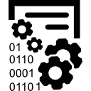

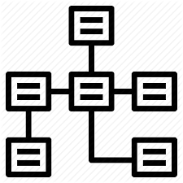

Architecture pattern: Enterprise data warehouse
Context An Enterprise Data Warehouse stores facts and dimensions form operational systems within the enterprise. An EDW typically supports business intelligence and analytic tools that pull aggregate data built off of fact data. The data warehouse was a term coined in the 1970s’ and represents an attempt to rollup operational information from the enterprise into a common source of enterprise information. The data transformations required to build an EDW have become, with larger data volumes, data variety, and business agility, increasingly difficult to manage and maintain.
Solution description Relational databases: EDW systems are typically built on analytic databases that support normalized and dimensional datasets. Often EDW systems support fast access to wide de-normalized data, using MPP architectures and columnar data stores. ETL Transformations: Historically EDW systems have required highly conformed datasets that require processing through extract-transform-load tools. Typically these ETL processes are built with integrated tools such as Informatica, and TalenD ODS: A mid layer tier in an EDW architect and operational datastore serves to store data in near real time from transactional systems, prior to ingestion into and EDW. BI Layer: Business intelligence tools are layered on top of dimensional data built on core fact tables in an EDW.
Rationale Direct access to historical transactional data systems is often slow and restricted in terms of access. Transactional systems are not optimized for large aggregations and queries. In addition, these systems are typically separated by domain within the company. To query and access data across the enterprise for analysis, a separate data store is required, that integrates data across the organization in a fact analytic data store. EDW MPP systems also typically have lower latency than “big data” stores on HDFS and in data lakes. They also have a SQL friendly interface for faster, interactive data access using various BI tools
Extract
Transform
Load
Summarize
Analyze
Data Provisioning
Analytic Data
ETL/ELT
ODS
Data Marts
Batch (Intraday, mini)
Load
Raw Data
EDW
OLAP
Analytics and BI
Normalized Data
Dimensional Data

Slide 46
Architecture pattern: (Near) Real time analytics
Context Real time analytics is an anti-pattern to Batch driven analytics. The real time is a relative to the speed at which data can be captured at the source system, transmitted to the data and analytic platform, processed and delivered to the end user or application for consumption. Establishing the goals for real time or near real time applications and considering the hardware and software constraints to meet the goals is an important architecture definition step.
Solution description The data hops must be reduced in order to increase the speed of data analytic result delivery to the consumption layer. Source systems must provide data in near real time to the data platform to meet the real time objectives. The source system transmit the source data as a data streams/events using a lower payload and a messaging infrastructure. In many cases, a time-series database or an in-memory processing engine is used to process the temporal data streams and persist the data. Vendor Specific architectures documented in the next section provide examples of tools and technologies to implement near real time analytic use cases.
Rationale The need for real time systems is growing twice as fast as the traditional batch oriented systems. This is necessitated by requirements of lower latency for data processing and more immediate refreshes to dashboards required for business decisions an
Spark streaming
Kafka
Messaging
Interfaces
Partition 0
Hive
HBase
Kafka Producer
Kafka Consumer
API Interfaces
Partition 1
Time Series
Redis MemSQL
Data Lake

Slide 47






Architecture pattern: Internet of Things (IoT)
Context IoT use cases require transmitting events and signals from devices and sensors with location and time context to either a peer or to a centralized data and analytics platform to analyze data and make decisions. IoT implementations use sensors/devices which capture events, transmits it over internet to a data hub which converts the signal using firmware to a time-series or event stream data. The high velocity, volume of data, sensor stability, internet based unreliable connectivity poses several challenges in analyzing the IoT stream data. The focus of this IoT pattern is Data and Analytics and it is assumed that devices, network are established by other standard patterns.
Solution description The integration layer communicates with devices using vendor provided device drivers to manage the devices and ingest device signals. When devices provide location and time context along with the signal data, it results in a series of real time streams. Some use cases require in-memory processing of the real time data to make decisions and take actions which are communicated to the actuators or devices (e.g. if boiler temperature > 32 F then release steam). The data is stored in data lake as a time-series or as a geo-spatial format. Rule engine and data science models are applied on the real time data. The actions can be fed to other real time applications or published to real time dashboards to take actions. The infrastructure and security, Data Governance concerns for IoT Pattern are similar to other data and analytics platform.
Rationale IoT architecture requires vendor devices/actuators, device drivers and communication layer. IoT hardware and firmware standards are emerging and lack standards. The real time data management patterns and data lake patterns must be used to meet the IoT use case goals.
Rule Engine
Real time Time Series Insight
IoT Hub
Data Lake
Stream Analytics
Real Time Apps
IoT Edge Devices
Data Science
Dashboards

Slide 48


Architecture pattern: Edge computing
Context Increase of smart devices in industrial and consumer area is growing exponentially. The amount of data being generated by these smart devices is unprecedented. Transmitting this data over wide area networks, removing noise from signal and processing at high velocity requires network bandwidth and dedicated resources for storage and processing
Solution description Edge computing improve the data processing by performing the data processing at the edge of the network, closer to the source of the data. Edge computing has several advantages: Improved Latency Bandwidth intensive contents much closer to the data source Unwanted data discarded Realtime alert Basic analytics at the edge Utilize decentralized processing power
Rationale Edge network computing is a required capability for several IOT use cases. For example, edge computing technologies are used in self-driving cars and medical devices that have low power requirements.
Industrial & Consumer Devices
(Data Source)
Edge Network
(LAN/WAN)
WAN/Internet
Data Filter
Real Time/NRT
Conformed Data
Controllers
Mini/Micro Batch
Data Warehouse
Basic Analytics
Dashboard
Data Storage
Sensors

Slide 49
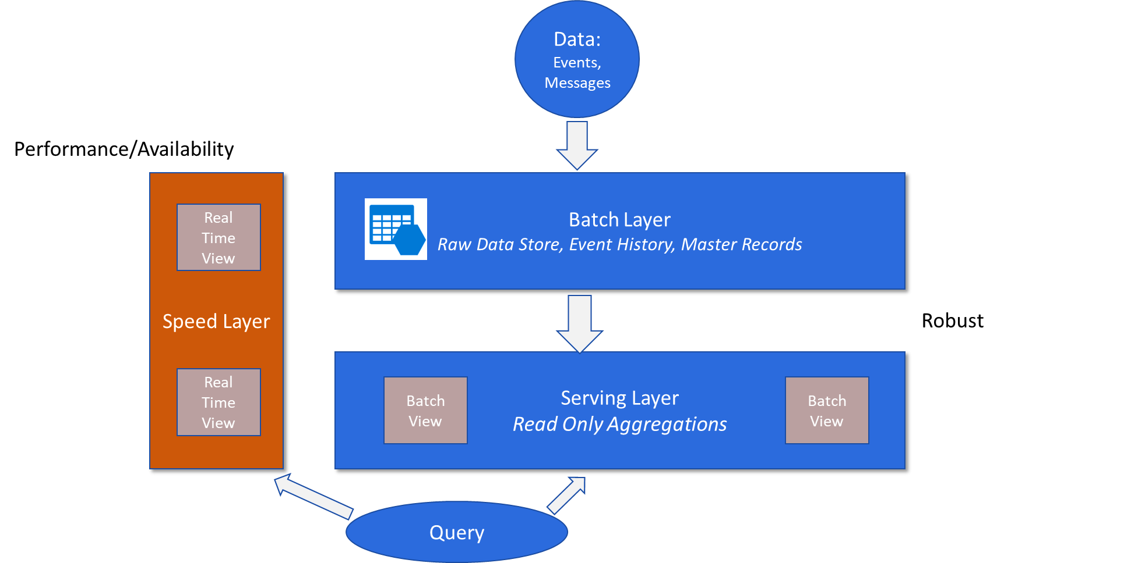
Design pattern: Lambda
Context A historical view of an organization’s data needs to be provided that typically involves some long running aggregations and building dimensional data stores. In addition, organizations face the need to track data in near real time. This is especially true for IOT data, and streaming data sources. The Lambda architecture is a pattern that addresses both these needs with a batch layer and separate speed layer. Note: Lambda must not be confused with AWS Lambda which refers to an AWS PaaS offering for serverless compute.
Solution description The Lambda architecture defines creating core batch processes that run on an immutable, append-only data store, on a periodic basis. CAP issues with consistency, partition tolerance, availability are simplified in batch mode. In parallel, a real-time system provides the latest data for up-to-the minute analysis. Real time data becomes replaced with the next batch cycle. The speed layer can be discarded, and rebuilt from scratch with incoming data, isolating the complexity of the R/W system. The batch process can be re-run end-to-end to support code patches, code changes. Query tools combine data from both systems in real time.
Rationale Seen as a way to simplify complex incremental processes layered on Enterprise data systems. Temporary failure of the speed layer does not impact batch reporting, and the batch layer can be rebuilt in the subsequent batch cycles, for a robust framework that supports both real time and historical data views.

Slide 50
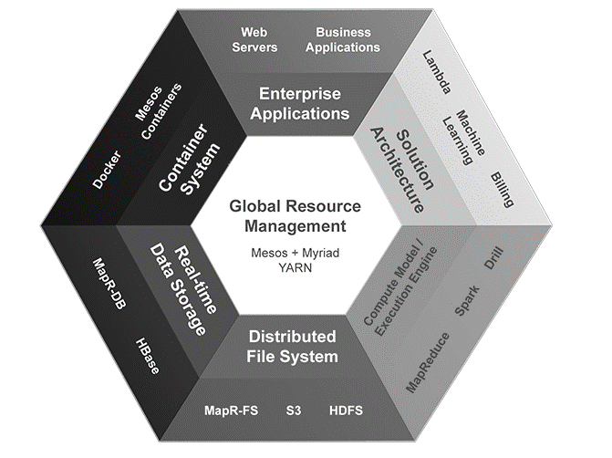
Design pattern: Zeta
MapR example of Zeta
Context: Zeta is a proposed holistic architecture for building an enterprise data system. With Zeta, the architecture helps define how Enterprise applications are built, as opposed to only providing a method of integration. In some ways it is an attempt to synthesize trends in modern cloud and hybrid architectures in a high-level architectural blueprint.
Solution description: The Zeta Architecture in built on top of pluggable components and provides a converged platform that have the following components: Distributed File System: HDFS, Cloud FS Real Time Data Storage: Streaming data available in real time, with standard query languages Dynamic Global Resource Management: Dynamic allocation of resources with common resource mgmt. Deployment/Container Management: Standardized software deployment in modular frameworks Pluggable Compute Model/Engine: Ability to deploy virtual compute engines on demand Solution Architecture: Applications that solve a specific business problem, as integrated SaaS style services Enterprise Applications: Built on these core components, the architecture supports the efficient development of EA systems. This is a MapR Offering for distributed computing on a converged platform
Rationale: Zeta is a way to reduce the time, resources and costs involved in building an enterprise architecture. It inherently supports the architectural principles of reducing data movement with distributed data storage, code re-use through common application components, unified solution architectures, as well as simplified testing frameworks.
https://mapr.com/solutions/zeta-enterprise-architecture/

Slide 51
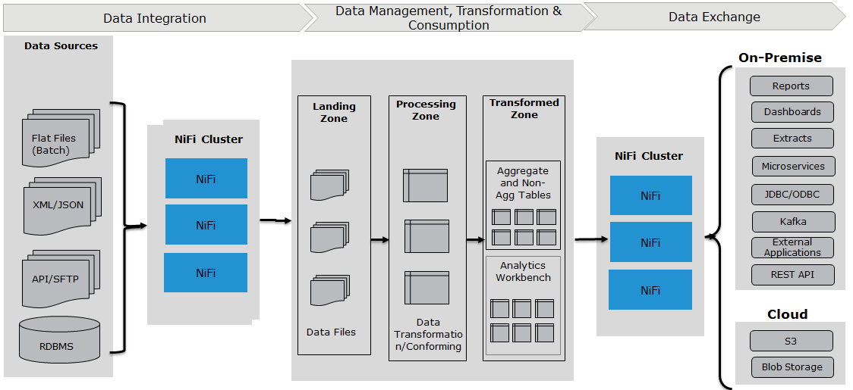
Design pattern: Ingestion (File based data ingestion using NiFi)
Context Batch data ingestion is most common data pattern to load data to the data and analytics platform at regular frequency from a variety of data sources and into various target repositories. Perform validations on the file and log the errors encountered in the data pipelines in to centralized Audit, Balance and Control Framework. Apache NiFi is dataflow automation component to route, distribute and to do simple data transformations. It is based on the "NiagaraFiles" software previously developed by the NSA, which is also the source of a part of its present name—NiFi. NiFi is available as a component in Hortonworks Data Platform.
Solution description NiFi provides data transfer, transform, and routing features for a wide (and expandable) set of data source and data sink technologies. Its not an ESB. NiFi focuses on providing async dataflows, i.e. async endpoints. It isn’t really suitable for handling extremely large data-blocks (multiple Megabytes). It does have nice tools for visualizing the flow of data through the system, and inspecting system state (on a per-node basis) Source systems drop the file to the staging data layer. NiFi reads the files from the staging layer at a specified frequency, performs validations on the file, parses the file in to records to perform record level validations. The records can be published to a messaging platform such as Kafka or NiFi can write the file to HDFS directories in the desired file format.
Rationale NiFi has a collection of reusable metadata driven processors to assemble data ingestion pipelines for structured files. NiFi is capable of ingesting data in both batches and real time. Nifi has data processors that connect with a wide array of technologies to ingest data thus reducing the pipeline creation time.

Slide 52
Design pattern: Consumption patterns
Context There are three consumption patterns to consume the data off the data and analytics platform. The requirements to view the analytical results and the speed of data processing are the drivers for the three capabilities.
Solution description Traditional BI is reporting and dashboard visualization capability build using business intelligence tools to support canned reports or ad-hoc reporting requirements. This requires the creation of a business sematic layer over a relational database. Real Time analytics require near real time data ingestion capabilities to process the data in memory to produce insights and interactive data refresh. Advanced analytics uses deep learning, search and other artificial intelligence techniques to obtain insights in the data and integrated within the business processes. Each of these consumption patterns use other data management patterns to bring the data to the data lake. Typically a data science workbench is included in the platform architecture to build and train models using a variety of programming tools and machine learning libraries
Rationale A project may require one of more of the specified consumption patterns and the choice of consumption patterns have the bearing on the overall architecture patterns to be implemented.
Data Sources
Ingest
Processing/Storage
Consumption
Internal
Data Lake
Datamart
ERP, MDM, POS, HR, Finance etc.
Batch/ Micro Batch
NoSQL Graph
Traditional BI
Raw
Data Store
Transform
Real Time
External
Advanced
Analytics
Real-Time/ Stream/ Events
Refined
Discovery/ Search
Advanced Analytics
Social Media, Third Party etc.
Extract
Mining/
Predictive

Slide 53





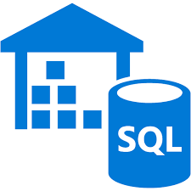


















Traditional BI consumption pattern
Sources
Ingestion/Prep
Processing/Storage
Consumption
Internal
Data Lake
Data Store & Marts
ERP, MDM, POS, HR, Finance etc.
Batch/Micro Batch
Raw
1
Data Store
Semantic
2
Reporting, Dashboards
& Visualization
Transform
External
NoSQL/Graph
3
Extracts & Delivery APIs
Real-Time/ Stream/Events
Social Media, Third Party etc.
Refined
AA
4
Discovery/ Search
Ad Hoc, Self Serve & Interactive
Mining/
Predictive
Extract
Trnstl/RT
Analytical
Governance, Health Check, Metadata & Security
1. Data stores
2. Semantic layer
3. Direct access to data lake
4. Extract or delivery API’s
Preferred method of catering to traditional BI needs is a data store—specialized DWH, a relational, MPP or anything in between
Examples of technologies:
Some traditional BI use cases does require pre agg views such as OLAP or in memory which enable lower latency on year over year reports or dissecting measures across various facts
Semantic layer can either connect to data store or directly sit on data lake platform
Examples of technologies:
Though not preferred but there can be use cases to directly access data lake for interactive and adhoc queries as soon as data becomes available
Data access latency might be high and consumption workloads needs to be managed
Examples of technologies:
Extracts can be generated from Data Lake layer and it or Data Store can also serve various client applications by APIs for delivering data securely
Examples of technologies:

Slide 54





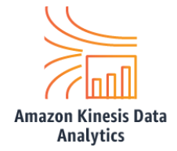


Real time analytics consumption pattern
Sources
Ingestion/Prep
Processing/Storage
Consumption
Internal
Data Lake
Data Store & Marts
Traditional BI
ERP, MDM, POS, HR, Finance etc.
Batch/Micro Batch
Raw
1
Transactional/Real Time
Data Store
Semantic
2
Transform
3
Real Time Analytics
External
NoSQL/Graph
Real-Time/ Stream/Events
Social Media, Third Party etc.
Refined
AA
Alerts/ Events
Discovery/ Search
Mining/
Predictive
Extract
Operational
Analytics
Analytical
Governance, Health Check, Metadata & Security
1. Real time streaming
2. Real time analytics
3. Operational analytics
To meet real time latency reqs, data should be ingested real time and enabled for real time analytics as soon as it is stored or while in motion
Examples of technologies:
Real time streaming enables actionable insights on data while it is in motion and when it is landed. This can lead to triggering events or alerts so that appropriate action is taken on time
Examples of Technologies:
Operational analytics can be applied to both business processes and IT processes
Infrastructure or cloud monitoring and business process monitoring some of the examples
Examples of Technologies:

Slide 55







Advanced analytics consumption pattern
Sources
Ingestion/Prep
Processing/Storage
Consumption
Internal
ake
Data Lake
Data Store & Marts
Traditional BI
ERP, MDM, POS, HR, Finance etc.
Batch/Micro Batch
Raw
Real-time
Data Store
Semantic
Advanced
Analytics
1
Transform
External
Real-Time/ Stream/Events
NoSQL/Graph
2
Discovery, Mining & Exploration
Social Media, Third Party etc.
Refined
AA
Discovery/ Search
Mining/
Predictive
Extract
Data Sciences/ Machine Learning
Governance, Health Check, Metadata & Security
1. EXPLORING DATA
2. Data Sciences—Models, ML, AI
Analytical use cases are more aligned to dig through troves of data and explore and discover insights which eventually help improve processes or systems
Examples of Technologies:
Advanced Analytics does cater to all other analytics by using modeling techniques to machine learning and leading to artificial intelligence
Examples of Technologies:

Slide 56
Design pattern: Audit, balance and control
Context Data from different data sources is transformed as it moves across the various layers of the data and analytics platform. It is essential to collect the metadata about the data movement on the data and analytics platform to manage the data catalog. The data linage of data across data pipelines should be maintained along with audit details such as number of records managed, date and time when records arrived on to a data layer. The audit data may capture to manage the data control processes such as control totals.
Solution description Audit Balance & Control (ABC) framework provides capabilities to log audit messages, error messages and pipeline statistics asynchronously to a relational data store (Oracle, SQL Server, MySQL etc.). Async capability is provided using a combination of an orchestration tool and messaging infrastructure. At the onset and finish of file ingestion, logs are created into the ABC job statistics tables. Any validations, errors and exceptions captured during data ingestion are also captured using ABC framework.
Rationale ABC data management framework provides audit information to balance totals and manage the linage of data across the data and analytics platform. It improves the data quality management processes and provides a way to manage the operational support of the data and analytics platform and supports job Restartability.
Orchestration tool
Managing DAG of tasks associated with a data pipeline

Slide 57
Design pattern: Read and write isolation
Read Only
Partition
R1
Context The on-demand and ad-hoc reporting and query requirements pose a challenge to maintain read and write isolation on the data lake because data lakes, specially Hadoop based architectures, lack transactions support and locking. A user may read inconsistent data (dirty read) from the data lake while the data is still being written.
Solution description Isolating the read partitions and write partitions in the data lake or analytical or tabular data models is required to avoid dirty reads. When the partition is written, user has access to an alternate read only consistent partition of the data and when the partition is replaced by a new then a custom switch process moves the end user transparently to this new partition. This switch is orchestrated for either a single fact or a functional domain to manage all dependencies. Elaborate access control mechanism has to be implemented as part of the data management pipelines to achieve it.
Rationale The pattern solves the read and write isolation for the Big Data based technologies.
Read Only
Partition
R2
Replace R1 by WR1 and mark it Read Only as R2
Remove User Access to R1 Partition
Write Complete
Switch?
Write Partition
WR1
Data Pipeline

Slide 58
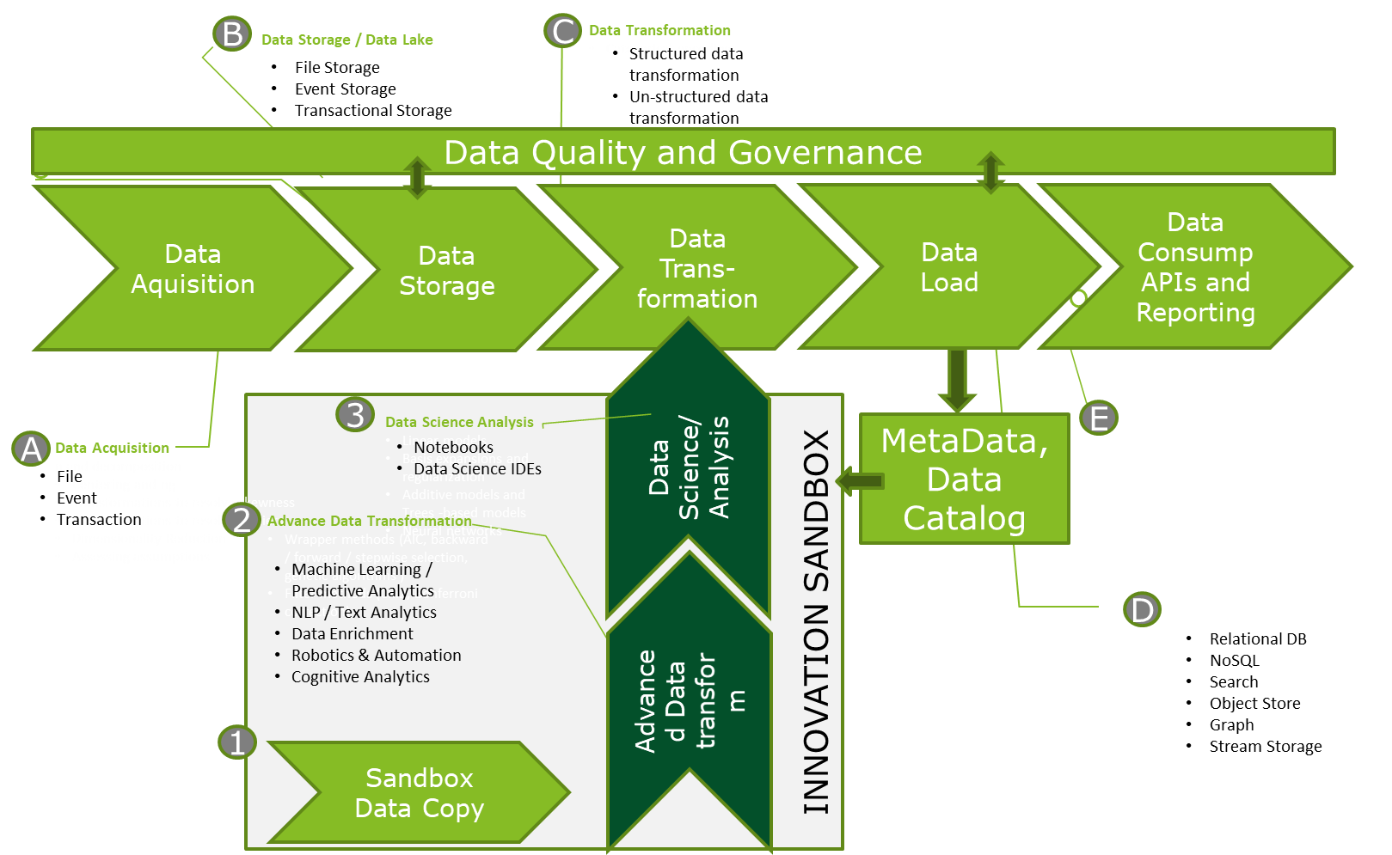
Best practice: DataOps
Context DataOps is as much an organizational model as technical architecture. The output of the “innovation process” or application replaces the “dev/design” phase of devOps. The production of data and information is analogous to “operations”, and is seen as similar to a “factory” or pipeline that produces value for the enterprise.
Solution description There are two dimensions in DataOps, one for delivering value by efficiently managing incoming production data using established data pipelines, where data is “manufactured”. The other involves managing “innovation” to refine the production of data and information in a separate sandbox environment that mirrors production. Analytics, ML and standard ETL should be code based, so version control and continuous testing and deployment is easily supported. Systems should be containerized or deployed as microservices to permit re-use across the organization, and between data science and production data engineering teams. Data Quality and metrics to support governance should be tightly integrated with production data processing to enforce quality standards. The data value pipeline is a streamlined manufacturing process, to be measured and optimized.
Rationale Modern data systems are in a process of ongoing change, yet they must also maintain robust and accurate data processes to support enterprise applications. Combining the need for incremental change, insights and innovation with ongoing data system reliability is the goal of the DataOps architecture.
Value Pipeline
Innovation Pipeline

Slide 59

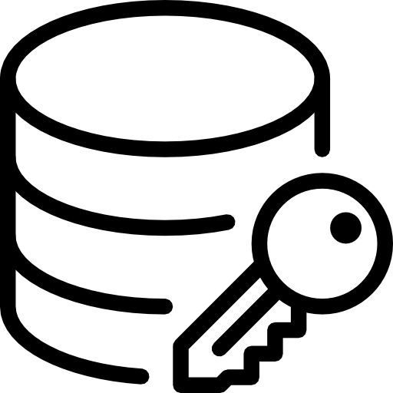



Best practice: Security
Context Enterprise Security architectures are comprised of the following components: People and process components, technical components, and governance components. Core technical components for enterprise data systems are addressed here. Broader security guidelines are contained in standards such as SABSA and the Open Information Security Management Maturity Model (O-ISM3).
Solution description Core technical components for Enterprise security involve the following: Identity and Access Management: Authentication and role based access management through common or federated IAM systems. Data and Content Protection: Data security, and data movement is controlled, using role based authentication and data encryption both in transit and at rest. This is required to address the PII/PHI/PCI/GDPR requirements. Border Protection: Access at the network layer is protected via network security, using zones, vpns, private links and authentication services Auditing/Logging: Data and processes are audited to determine compliance, and data integrity. Threat Detection: Intrusion events are monitored with automated alerting. Cloud computing addresses many of these components using a combination of technologies.
Rationale Data Security protects the customer, and it protects the business and the business reputation. It mitigates the risks associated with loss of sensitive data. Security standards and templates also serve to guide both network and data architectures, and provide an on going measure of their integrity
Zone
Auditing and Logging
D
Zone
Data Acquisition
Data Storage
Data Transform
Data Load
Consume. APIs and Reporting
B
Encryption in Motion
B
Encryption at Rest.
A
Identity and Access Management.
E
Security Scanner.
C
Border Protection: VPN/Privatelink/Proxy, etc.

Slide 60
Technology vendor specific architecture

Slide 61
Technology vendor architectures
Cloud Computing Reference Architecture
Cloud Consumer
Service Orchestration
Cloud Provider
Cloud Broker
Service Layer
Cloud Service Management
Security
Privacy
The On-demand software, platform and infrastructure services is an attractive proposition to customer from the cloud vendors namely— Amazon Web Services, Azure and Google Cloud Services.
On-demand SaaS and PaaS platforms provide elasticity to scale up and down reducing the platform and software costs. Cloud based data and analytics platform can be build as a hybrid cloud or cloud native platform.
Adoption of cloud poses Security, Integration and, Cost Management challenges. Additional security architecture patterns must be implemented to secure sensitive data.
SaaS
Business Support
PaaS
Service Intermediation
Cloud Auditor
IaaS
Service Aggregation
Security Audit
Provisioning/ Configuration
Resource Abstraction & Control Layer
Privacy Impact Audit
Service Arbitration
Hardware
Portability/ Interoperability
Performance Audit
Facility
Cloud Carrier
Adopted from NIST Cloud Computing Reference Architecture

Slide 62
AWS reference architecture

Slide 63




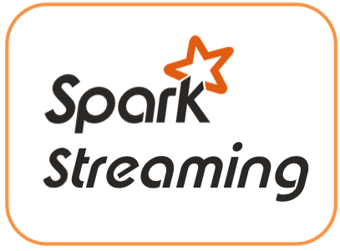
AWS reference architecture
Enterprise Data Governance
BI/Analytics/IOT Workloads
Developer and Management Tools
DATA SOURCES
INGEST
DATA STORAGE AND PROCESSING
INFORMATION DELIVERY
INFORMATION CONSUMERS
Business Applications
Data Movement
Ingestion Methods
Landing Zone and Data Lake (AWS S3)
Data Storage and Provisioning
Business Intelligence Platform—QuickSight (AtScale, Cognos, MicroStrategy, etc.)
Functional Users
Customer & Distribution
Production Data Lake
Business Consumers/ Analytics
AWS Direct Connect
Batch ETL & ELT—AWS Glue
(Informatica, Talend)
Raw Layer
Processed Layer
Consumption Layer
Analytics Marts—AWS Redshift
Finance and Accounting
Marketing, Sales & Distribution
File (Batch, Intra-day batch, mini-batch)
Data based on Applications
Cleansed Data from Applications
(Visualization, Dashboards, Transactional Analytics)
Structured Data by Domains
Advanced Analytics/ ML—SageMaker, AWS ML, Rekognition, etc.
Corporate Business Functions and HR
ERP
AWS Storage Gateway
Raw Files
DQ Applied Files
Analytical Datasets
Atomic Data Marts/ODS—AWS RDS
Messaging Batch—AWS Kinesis Firehose
External data
Consumption Ready External Data
Unstructured Data
(Text Analytics, Predictive Modeling, Data Mashup)
Data Scientist Community
HR & Finance
…
…
External Data
Analytics and Visualization—QuickSight (Tableau, Qlik)
External Consumers
AWS Database Migration
Service
Web Services—NiFi
Master Data Mgmt.
Research Data Lake
In-Memory Processing —Presto on EMR
Information Access Channels
(Processing, Analysis, Visualization)
Other RDBMS
AWS CLI S3
Stream Ingestion
Analytical Processing
Streaming Analytics (Kibana)
Portals
Data Streams/Sync Messaging—AWS Kinesis
(Confluent Kafka/ NiFi)
Batch/Micro-Batch Processing (AWS EMR, Data Bricks)
Interactive Querying —AWS Athena
(Real-time dashboards and transactional applications)
Mobile
Other Data Sources
Real-time Search—AWS Elastic Search
Enterprise Search
IOT Data
AWS S3 Transfer Acceleration
Stream Processing (AWS MR, Kinesis)
IOT Processing (AWS IoT Analytics)
Analytics/ML
Model Repository
Unstructured Data
Enterprise Applications
Geospatial Data
External Data
AWS Identity & Access Management
AWS Key Management Service
AWS CloudTrail
AWS CloudWatch (Data Dog)
AWS Management Console
AWS Directory Service
AWS CloudFormation (Ansible)
Code Repository (Git, Bit Bucket)
AWS Code Deploy (Jenkins/Circle CI)
Live Streams
Enterprise Content Management
Data Quality Management
Metadata Management
Data Security & Privacy
Master and Reference Data Management
Business Rules Management
Audit, Balance and Control
Data Catalog and Discovery

Slide 64
AWS data and analytics component details
Function | AWS component | Description
Data movement | AWS Direct Connect | Provides an easy to establish dedicated network connection from client’s premises (data center, office, or colocation environment) to AWS, resulting in reduced network costs, increased bandwidth throughput and more consistent network.
 | AWS Storage Gateway | A hybrid storage service that enable client’s on-premises applications to seamlessly use AWS cloud storage, utilizing it for backup and archiving, disaster recovery, storage tiering, and migration.
 | AWS Database Migration Service | A service that provides seamless and secure integration between client’s on-premises IT environment and AWS’s storage infrastructure for scalable and cost effective storage (e.g. Oracle to Oracle, Heterogeneous migrations—Oracle to Amazon Aurora or Microsoft SQL Server to MySQL). It also enables streaming data to Amazon Redshift, Amazon DynamoDB, and Amazon S3 from any of the supported sources including Amazon Aurora, PostgreSQL, etc.
 | AWS S3 Transfer Acceleration | Utilizes the CloudFront Edge Network to accelerate uploads to S3 by providing capability to upload the data directly to edge locations, which in turn will transfer the files to S3. This reduces the latency for transfers across the regions.
Data ingestion and integration (batch and streaming) | AWS Glue | A Fully managed serverless ETL (extract, transform and load) service that makes it simple and cost-effective to categorize, clean, enrich and move data between various data stores. It provides automatic generation of Python or Scala code, a flexible scheduler that handles dependency resolution, job monitoring, and retries.
 | AWS Kinesis Data Firehose | A fully managed service for delivering real-time streaming data to destinations such as Amazon S3, Amazon Redshift, and Amazon Elasticsearch Service.
 | AWS Kinesis | A Platform to consume and process big and streaming data into AWS. Kinesis makes it easy to load and analyze the streaming data and provides ability to build custom applications as per the business needs.
 | AWS Data Pipeline | A web service that helps to move, integrate, and process data across AWS compute and storage resources, as well as the on-premises data sources. It enables regular access to the data where it’s stored, transform and process it at scale, and efficiently transfer the results to AWS services such as Amazon S3, Amazon RDS, Amazon DynamoDB, and Amazon EMR.
 | AWS Simple Notification Service (SNS) | A web service that coordinates and manages the delivery or sending of messages to subscribing endpoints or clients. It provides developers with a highly scalable, flexible, and cost-effective capability to publish messages from an application and immediately deliver them to subscribers or other applications.
 | AWS Simple Queue Service (SQS) | A fully managed message queuing service that makes it easy to decouple and scale microservices, distributed systems, and serverless applications. SQS makes it simple and cost-effective to decouple and coordinate the components of cloud application.
Storage | AWS S3 | An enterprise-wide data lake storage repository for big data analytic workloads. S3 standards for Simple storage service(S3) and provides a highly secure, durable, scalable object storage with an easy to use simple web service interface to store and retrieve any amount of data from anywhere on the web.
 | Glacier | An extremely low-cost storage service that provides secure, durable, and flexible storage for data backup and archival to ensure low-cost storage.

Slide 65
AWS data and analytics component details (cont.)
Function | AWS component | Description
Databases and data management | AWS RDS | Amazon RDS service provides six different DB engines (Postgres, MySQL, Oracle, etc.) and makes it easy to set up, operate, and scale relational database for OLTP in cloud. It provides cost-efficient, and resizable capacity while managing time-consuming database administration tasks and available on several database instance types—optimized for memory, performance or I/O.
 | AWS Redshift | A fully managed, columnar storage, petabyte-scale data warehouse solution (OLAP) that makes it simple and cost-effective to efficiently analyze data using SQL standards and existing business intelligence tools. It enables the execution of complex analytical queries against petabytes of structured data, using sophisticated query optimization, columnar storage on high-performance local disks, and massively parallel query execution.
 | AWS Aurora | A MySQL and PostgreSQL compatible relational database built for the cloud, that combines the performance and availability of high-end commercial databases with the simplicity and cost-effectiveness of open source databases.
 | AWS Dynamo DB | A fully managed cloud NoSQL database that supports both document and key-value store models for all applications that need consistent, single-digit millisecond latency at any scale.
 | AWS ElasticCache | A fully managed, in-memory data store service through Redis or Memcached for various data-intensive apps or to improve the performance of existing apps by retrieving data from high throughput and low latency in-memory data stores.
Data processing and compute | AWS EMR | A managed Hadoop framework that makes it easy, fast, and cost-effective to process vast amounts of data across dynamically scalable Amazon EC2 instances. EMR provides the capability to run other distributed frameworks, e.g. Spark, Presto, Flink, etc. and interact with data in other AWS data stores such as Amazon S3.
 | AWS Lambda | A serverless event-driven compute service that allows to run code without provisioning or managing of servers. The code can be run for virtually any type of application or backend service, with zero administration.
Interactive querying and analytics | AWS Athena | A serverless, interactive query service that makes it easy to analyze petabytes of data in Amazon S3 with no data warehouses or clusters to manage.
 | AWS Elastic Search | A fully managed service that delivers Elasticsearch’s easy-to-use APIs and real-time analytics capabilities alongside the availability, scalability, and security for production workloads. It integrates with Kibana, Logstash, and AWS services including Amazon Kinesis Data Firehose and AWS Lambda for real-time analytics, log monitoring, and clickstream analytics.
 | AWS QuickSight | A fast, cloud-powered business analytics service that makes it easy to build visualizations, perform ad-hoc analysis, and quickly get business insights from the data.
 | Presto on EMR | An open-source distributed SQL query engine optimized for low-latency, ad-hoc analysis, and interactive querying on large volumes of data. It supports the ANSI SQL standard, including complex queries, aggregations, joins, and window functions. Presto on EMR can enable interactive analytics to the speed of commercial data warehouses while scaling to the size of large organization with petabyte scale data in Amazon S3.

Slide 66
AWS data and analytics component details (cont.)
Function | AWS component | Description
Advanced analytics, ML, and IOT | AWS SageMaker | A fully-managed platform that enables developers and data scientists to quickly and easily build, train, and deploy machine learning models at any scale. It includes hosted Jupyter notebooks that make it easy to explore and visualize the training data stored in Amazon S3.
 | AWS Comprehend | A continuously-trained Natural Language Processing (NLP) service that uses machine learning to find insights and relationships across unstructured text like customer reviews and news articles.
 | AWS Lex | A service for building conversational interfaces into any application using voice and text, enabling developers to bring sophisticated, natural language chatbots to applications.
 | AWS Machine Learning | A managed service for building ML models and generating predictions that enable the development of robust, scalable smart applications.
 | AWS IoT Analytics | A fully-managed service that makes it easy to run sophisticated analytics on massive volumes of IoT data. It simplifies running analytics on IoT data to get insights for better and more accurate decisions for IoT applications and machine learning use cases.
 | AWS Greengrass | Amazon’s IOT service that lets devices process the data they generate locally, while still taking advantage of AWS services when an internet connection is available.
 | TensorFlow on AWS | Framework that enables developers to quickly and easily get started with deep learning in cloud.
DevOps and operations management | AWS Identity Access and Management (IAM) | A Service that allows to manage users and their level of access to the AWS console and integrates with many different AWS services. It provides centralized control and shared access of AWS accounts, granular permissions, identity federation, multifactor authentication and password rotation policy.
 | AWS Key Management Service | A managed service to create and control the encryption keys used to encrypt data, and uses FIPS 140-2 validated hardware security modules to protect the security of the keys.
 | AWS CloudFormation | A Service that allows to quickly and easily model and provision infrastructure resources and applications in an automated and secure manner on AWS.
 | AWS CodeCommiit | a fully-managed source control service that makes it easy for clients to host secure and highly scalable private Git repositories.
 | AWS CodeDeploy | A service that automates software deployments to a variety of compute services including Amazon EC2, AWS Lambda, and instances running on-premises.
 | AWS CloudTrail | A service that enables governance, compliance, operational auditing—log, continuously monitor, and retain account activity related to your AWS infrastructure.
 | AWS CloudWatch | A monitoring service for AWS cloud resources and the applications that runs on AWS. CloudWatch can be used to collect and track metrics, collect and monitor log files, set alarms, and automatically react to changes in your AWS resources.
 | AWS Directory Service | Directory Service for Microsoft AD, enables your directory-aware workloads and AWS resources to use managed Active Directory in the AWS Cloud.

Slide 67
Azure reference architecture

Slide 68


Azure reference architecture
BI/Analytics/IOT Workloads
Enterprise Data Governance
DATA SOURCES
INGEST
DATA STORAGE AND PROCESSING
INFORMATION DELIVERY
INFORMATION
CONSUMERS
Business Applications
Data Movement
Ingestion Methods
Landing Zone and Data Lake (Azure HD Insight)
Data Storage and Provisioning
BI Platform—PBI, SSAS,SSRS, AtScale, MicroStrategy
Functional Users
Customer & Distribution
Production Data Lake
Business Consumers/ Analytics
Data Management
Gateway
Batch ETL & ELT
Azure ADF, Polybase
Informatica, Talend, Apache NiFi, MFT
Raw Layer
Processed Layer
Consumption Layer
Analytics Marts Azure SQL DW
(Visualization, Dashboards, Transactional Analytics)
Marketing, Sales & Distribution
Data based on Applications
Cleansed Data from Applications
Adv Analytics/ML Azure ML SparkML, R, SciPy, Alteryx
Finance and Accounting
Structured Data by Domains
Corporate Business Functions and HR
ERP
AZ Copy
Raw Files
DQ Applied Files
Analytical Datasets
ODS Azure SQL DB, SQL Server 2016
(Text Analytics, Predictive Modeling, Data Mashup)
Async Messaging Azure Event Hub
External data
Consumption Ready External Data
Unstructured Data
Visualization PBI Services, Excel, Tableau
Data Scientist Community
HR & Finance
Messages…
External Data
External Consumers
Azure Express Route
Web Services Azure Logic Apps Apache NiFi
Master Data Mgmt.
Research Data Lake Azure Data Lake Store, Azure Blob Storage
In-Memory Processing SSAS Tabular
(Processing, Analysis, Visualization)
Information Access Channels
Other RDBMS
Analytical Processing
Streaming Analytics (Kibana, Spark Streaming)
DB Connectors
NiFi, Attunity, Golden Gate
Stream Ingestion
Batch/Micro-Batch Processing (Azure HD Insight, Azure Data Bricks)
Portals
Azure Event Hub
Interactive Querying Polybase, U-SQL,
(Real-time dashboards and transactional applications)
Mobile
Other Data Sources
Enterprise Search
IOT Data
APIs Internal/External
Confluent Kafka/ Apache NiFi
Stream Processing Stream Analytics, Azure Functions
IOT Processing Azure IOT Hub, Azure Functions
Real-time Search ELK
Analytics/ML
Model Repository
Enterprise Applications
Unstructured Data
Geospatial Data
External Data
Developer and Management Tools
Live Streams
Azure Multi-Fact Auth
Azure Key Vault
Operations Management Suite
Azure VMs Azure Site Recovery
Azure Portal
Azure Active Directory
Azure Container Services Ansible
Code Repository VSTS, Git, Bit Bucket, Jenkins
Azure Data Catalog
Enterprise Content Management
Data Quality Management
Metadata Management
Data Security & Privacy
Master and Reference Data Management
Business Rules Management
Audit, Balance and Control
Data Catalog and Discovery

Slide 69
Azure data and analytics component details
Function | Azure component | Description
Data movement | Data Management Gateway | A client agent that one must install in your on-premises environment to copy data between cloud and on-premises data stores
 | AZ Copy | AzCopy is a command line and API interface to load data as blobs to Azure Storage accounts
 | Azure Express Route | An Azure service that lets you create private connections between Microsoft datacenters and infrastructure that's on your premises or in a colocation facility.
Data ingestion and integration (batch and streaming) | Azure ADF, | A managed cloud service that's built for these complex hybrid extract-transform-load (ETL), extract-load-transform (ELT), and data integration projects.
 | Async Messaging Azure Event Hub | Azure Event Hubs is a big data streaming platform and event ingestion service. It can receive and process millions of events per second. Data sent to an event hub can be transformed and stored by using any real-time analytics provider or batching/storage adapters.
 | Azure Logic Apps | Azure Logic Apps is a cloud service that helps you automate and orchestrate tasks, business processes, and workflows when you need to integrate apps, data, systems, and services across enterprises or organizations.
 | Confluent Kafka | Confluent, founded by the creators of Apache Kafka, delivers a complete execution of Kafka for the Enterprise, to help you run your business in real time.
 | Apache NiFi | Apache NiFi supports powerful and scalable directed graphs of data routing, transformation, and system mediation logic.
Storage | Azure HD Insight | A Hadoop service offering hosted in Azure that enables clusters of managed Hadoop instances. Azure HDInsight deploys and provisions Apache Hadoop clusters in the cloud, providing a software framework designed to manage, analyze, and report on big data with high reliability and availability.
 | Azure Blob storage | Azure Blob storage stores massive amounts of unstructured object data, such as text or binary data and is highly scalable and available

Slide 70
Azure data and analytics component details (cont.)
Function | Azure component | Description
Databases and data management | Azure SQL DW | A cloud-based Enterprise Data Warehouse (EDW) that leverages Massively Parallel Processing (MPP) to quickly run complex queries across petabytes of data.
 | Azure SQL DB, SQL Server 2016, Azure Database for PostgreSQL Azure Database for MySQL | A fully managed relational database service for app development and deployment with built-in capabilities, such as high availability, at no extra cost.
 | Table Storage | Stores large amounts of structured data. The service is a NoSQL datastore which accepts authenticated calls from inside and outside the Azure cloud
Data processing and compute | Apache Kafka | Apache Kafka provides batch and message processing capabilities
 | Redis Cache | A in-memory data structure store, used as a database, cache and message broker
 | SSAS Tabular | A tool to create cubes using data from data marts/data warehouse for deeper and faster data analysis
Interactive querying and analytics | Poly Base | A technology that accesses data outside of the database via the t-sql language. In SQL Server 2016, it allows you to run queries on external data in Hadoop or to import/export data from Azure Blob Storage. Queries are optimized to push computation to Hadoop
 | U-SQL | U-SQL is the new big data query language of the Azure Data Lake Analytics service.
 | ELK | Using Microsoft Azure enables to run the components of the Elastic Stack (Elasticsearch, Kibana, Logstash, and Beats)—and to ingest data from various applications and Azure components

Slide 71
Azure data and analytics component details (cont.)
Function | Azure component | Description
Advanced analytics, ML, and IOT | Stream Analytics (IoT) | A managed event-processing engine set up real-time analytic computations on streaming data
 | Azure Machine Learning Services | An extensible, scalable platform for integrating machine learning tasks and tools with the applications that consume machine learning services.
 | Microsoft Speech API | Provides developers an easy way to create powerful speech-enabled features in their applications, like voice command control, user dialog using natural speech conversation, and speech transcription and dictation. The Microsoft Speech API supports both Speech to Text and Text to Speech conversion.
 | Translator Speech | A cloud-based automatic translation service. The API enables developers to add end-to-end, real-time, speech translations to their applications or services
 | Computer Vision | Provides developers with access to advanced algorithms for processing images and returning information.
 | Face API | A cloud-based service that provides the most advanced face algorithms.
 | Content Moderation | A machine-assisted image moderation and human review tool to moderate images for adult and racy content
 | Text Analytics | A cloud-based service that provides advanced natural language processing over raw text, and includes three main functions: sentiment analysis, key phrase extraction, and language detection.
DevOps and operations management | Multifactor Authentication | A security system that requires more than one method of authentication from independent categories of credentials to verify the user's identity for a login or other transaction
 | Azure Key Vault | A cloud-hosted management service that allows users to encrypt keys and small secrets by using keys that are protected by hardware security modules (HSMs).
 | Site Recovery | A service for orchestrating and automating replication of Azure VMs between regions, on-premises virtual machines and physical servers to Azure, and on-premises machines to a secondary datacenter
 | Azure Active Directory | A fully managed multi-tenant service from Microsoft that offers identity and access capabilities for applications running in Microsoft Azure and for applications running in an on-premises environment.
 | VSTS | An integrated development environment (IDE) developed as a software product by Microsoft Corp. to facilitate software project creation, development and management.
 | Microsoft Operations Management Suite | A cloud based configuration and operations management tool providing services such as log analytics, automation, backup and site recovery. It can be used to manage hybrid cloud infrastructure by integrating with system center.
 | Azure Portal | A web portal to view and manage all of azure applications in one unified hub—including web apps, databases, virtual machines, virtual networks, storage, and Visual Studio team projects
 | Azure Container Service | A managed Kubernetes service offers rapid VM deployments and automated management of the client clusters using industry standard orchestrators such as Docker & Mesosphere.

Slide 72
Google Cloud Platform (GCP) reference architecture

Slide 73





























GCP reference architecture
BI/Analytics/IOT Workloads
Data Sources
Data Storage and Processing
Information Delivery and API Platforms
Information Consumers
Business Applications
Data Movement
Ingestion Methods
Landing Zone and Data Lake
Databases & Big Data
Business Intelligence
Data Studio, Cloud Datalab
API Platform
Google Maps platform
Functional Users
Google Transfer Appliance
Batch ETL & ELT Cloud Dataflow
Business Consumers / Analytics
Customer & Distribution
Production Data Lake
Cloud Storage
Raw Layer
Data based on Applications
Raw Files
External data
…
Processed Layer
Cleansed Data from Applications
DQ Applied Files
Consumption Ready External Data
…
Consumption Layer
Structured Data by Domains
Analytical Datasets
Unstructured Data
External Data
Analytics
API Analytics
API Platform
Apigee API platform
Finance and Accounting
Marketing, Sales & Distribution
Cloud Storage Transfer Service
Messaging Batch Cloud Spanner
Cloud SQL
Corporate Business Functions and HR
ERP
Cloud Datastore
API Intelligence
Apigee Sense, Cloud Endpoints
Monetize
API Monetization
Corporate Business Functions and HR
HR & Finance
Data Scientist Community
Google Big Query Data Transfer
Web Services
NiFi
Cloud Memory store
External Consumers
Master Data Mgmt.
Advanced Analytics/ML and Cloud AI
Other RDBMS
Research Data Lake
Persistent Disk
Cloud AutoML, Cloud Machine Learning Engine
Cloud Natural Language, Cloud Speech-to-Text, Text-to-Speech
Stream Ingestion
Information Access Channels
Cloud Dataprep
Data Processing
Big Query
Portals
Other Data Sources
Data Streams/ Sync Messaging
Pub Sub
Cloud TPU
TensorFlow
Dialogflow Enterprise Edition
IoT Data
Managed Hadoop and Spark Service Cloud Dataproc
Genomics
Mobile
Cloud Composer
Enterprise Search
Unstructured Data
Stream Processing Cloud Dataflow
Cloud IoT Core
Cloud Bigtable
Cloud Vision API, Video Intelligence API
Cloud Job Discovery
Geospatial Data
Enterprise Applications
External Data
Identity and Security, Developer and Management Tools
Live Streams
Identity and Access Mgmt
Cloud Key Mgmt Service
Access Transparency, Security Scanner
Stackdriver, Monitoring,
Logging, Trace
Cloud Console,
Error Reporting
Cloud Deployment Manager
Cloud Security Command
Center
Cloud Source Repository (Git, Bit Bucket), plugins
Container Builder
Enterprise
Data
Governance
Enterprise Content Management
Data Quality Management
Metadata Management
Data Security and Privacy
Master and Reference Data Management
Business Rules Management
Audit, Balance and Control
Data Catalog and Discovery

Slide 74
GCP data and analytics component details
Function | AWS component | Description
Data movement | Google Transfer Appliance | Select between 100 TB and 480 TB rackable appliances to securely ship your data to Google Cloud Storage
 | Cloud Storage Transfer Service | Transfer your data from one cloud to another
 | Google BigQuery Data Transfer | Schedule and automate data transfers from your SaaS applications to Google BigQuery
 | Cloud Composer | Fully managed workflow orchestration service that empowers you to author, schedule, and monitor pipelines that span across clouds and on-premises data centers. Built on the popular Apache Airflow open source project and operated using the Python programming language, Cloud Composer is free from lock-in and easy to use
 | Cloud Data prep | Google Cloud Data prep is an intelligent data service for visually exploring, cleaning, and preparing structured and unstructured data for analysis. Cloud Data prep is serverless and works at any scale. There is no infrastructure to deploy or manage
Data ingestion and integration (batch and streaming) | Cloud Dataflow | A unified programming model and a managed service for executing a wide range of data processing patterns including streaming analytics, ETL, and batch computation
 | Cloud Dataproc | A managed Spark and Hadoop service, to easily process big datasets using the powerful and open tools in the Apache big data ecosystem. Cloud Dataproc integrates with storage, compute, and monitoring services across Cloud Platform products, giving you a powerful and complete data processing platform
 | Cloud Pub/Sub | Google Cloud Pub/Sub is a serverless, large scale, reliable, real-time messaging service that allows you to send and receive messages between independent applications. You can leverage Cloud Pub/Sub’s flexibility to decouple systems and components hosted on Cloud Platform or elsewhere on the Internet
Storage | Cloud Storage | Object storage with global edge caching
 | Cloud Memory store | Fully managed in-memory data store service built on scalable, more secure, and highly available infrastructure managed by Google. Best for building application caches that provides sub-millisecond data access. Compatible with the Redis protocol, allowing easy migration with zero code change
 | Persistent Disk | High-performance block storage service suitable for Virtual Machines and container storage. Additionally, Persistent Disk offers multi-reader mounts and on-demand volume resizing to simplify operations

Slide 75
GCP data and analytics component details (cont.)
Function | AWS component | Description
Databases and data management | Cloud SQL | Fully-managed database service that makes it easy to set up, maintain, manage, and administer your relational MySQL and PostgreSQL databases in the cloud
 | Cloud Bigtable | Massively scalable NoSQL database suitable for low-latency and high-throughput workloads. It integrates easily with popular Big Data tools like Hadoop and Spark and it supports the open-source, industry-standard HBase API
 | Cloud Spanner | Fully managed, mission-critical relational database service built from the ground up and battle tested for transactional consistency, high availability, and global scale. With traditional relational semantics (schemas, ACID transactions, SQL) and automatic, synchronous replication with high availability
 | Cloud Datastore | An elastic, highly available document-oriented database as a service. It is fully managed so you don’t need to deploy, update, configure, or manage your database solution. Ideal for mobile and web workloads
 | BigQuery | Fully managed, low cost analytics data warehouse. BigQuery is serverless, there is no infrastructure to manage, no need to guess the needed capacity or overprovision, and you don't need a database administrator
 | Cloud Datastore | An elastic, highly available document-oriented database as a service. It is fully managed so you don’t need to deploy, update, configure, or manage your database solution. Ideal for mobile and web workloads
Data processing and compute | Cloud Datalab | Google Cloud Datalab is an interactive notebook (based on Jupyter) to explore, collaborate, analyze and visualize data. It is integrated with BigQuery and Google Cloud Machine Learning to give you easy access to key data processing services
Interactive querying and analytics | Compute Engine | Virtual machines running in Google's innovative data centers and worldwide fiber network
 | App Engine | Platform for building scalable web applications and mobile and IoT backends. App Engine provides you with built-in services and APIs, such as NoSQL datastores, MemCache, and a user authentication API, common to most applications
 | Kubernetes Engine | Powerful cluster manager and orchestration system for running Docker containers. Kubernetes Engine schedules containers into the cluster, keeps them healthy and manages them automatically based on requirements you define (such as CPU and memory)
 | Container Registry | Store your private container images on Cloud Platform for fast, scalable retrieval and deployment. Google Cloud Container Registry is a private Docker repository that works with popular continuous delivery systems
 | Cloud Functions | Cloud computing has made possible fully serverless models of computing where logic can be spun up on-demand in response to events originating from anywhere. With Cloud Functions, you can construct applications from bite-sized business logic billed to the nearest 100 milliseconds, only while your code is running

Slide 76
GCP data and analytics component details (cont.)
Function | AWS component | Description
Advanced analytics, ML, and IOT | Cloud Speech-to-Text | Google Cloud Speech-to-Text enables developers to convert audio to text by applying powerful neural network models in an easy to use API. The API recognizes 120 languages and variants, to support your global user base. You can enable voice command-and-control, transcribe audio from call centers, and more. It can process real-time streaming or pre-recorded audio, using Google’s machine learning technology
 | Cloud Text-to-Speech | Google Cloud Text-to-Speech enables developers to synthesize natural-sounding speech with 32 voices, available in multiple languages and variants. It applies DeepMind’s groundbreaking research in WaveNet and Google’s powerful neural networks to deliver the highest fidelity possible. As an easy-to-use API, you can create lifelike interactions with your users, across many applications and devices
 | Cloud Translation API | Google Cloud Translation API provides a simple programmatic interface for translating an arbitrary string into any supported language. Translation API is highly responsive, so websites and applications can integrate with Translation API for fast, dynamic translation of source text from the source language to a target language (e.g. French to English)
 | Cloud Vision API | Google Cloud Vision API enables you to understand the content of an image by encapsulating powerful machine learning models in an easy to use REST API. It quickly classifies images into thousands of categories (e.g. "sailboat", "Eiffel Tower"), detects individual objects and faces within images, and finds and reads printed words contained within images
 | Cloud Video Intelligence API | Google Cloud Video Intelligence API makes videos searchable and discoverable by extracting metadata, identifying key nouns, and annotating the content of the video. By calling an easy-to-use REST API, you can now search every moment of every video file in your catalog and find each occurrence of key nouns as well as its significance. Separate signal from noise, by retrieving relevant information by video, shot, or frame
 | Cloud AutoML | Cloud AutoML is a suite of Machine Learning products that enables developers with limited machine learning expertise to train high quality models by leveraging Google’s state of the art transfer learning, and Neural Architecture Search technology. AutoML Vision is the first product to be released. It is a simple, secure and flexible ML service that lets you train custom vision models for your own use cases. Soon, Cloud AutoML will release other services for all other major fields of AI
 | Cloud Machine Learning Engine | Google Cloud Machine Learning Engine makes it easy for you to build sophisticated, large scale machine learning models that cover a broad set of scenarios from building sophisticated regression models to image classification. It is portable, fully managed, and integrated with other Google Cloud Data platform products such as Google Cloud Storage, Google Cloud Dataflow and Google Cloud Datalab so you can easily train your models
 | Cloud Job Discovery | Google Cloud Job Discovery provides highly intuitive job search that anticipates what job seekers are looking for and surfaces targeted recommendations that help them discover new opportunities. In order to provide the most relevant search results and recommendations, the API uses machine learning to understand how job titles and skills relate to one another, and what job content, location and seniority are the closest match for a jobseeker’s preferences
 | Cloud Natural Language | Google Natural Language API reveals the structure and meaning of text by offering powerful machine learning models in an easy to use REST API. You can use it to extract information about people, places, events and much more, mentioned in text documents, news articles or blog posts. You can also use it to understand sentiment about your product on social media or parse intent from customer conversations happening in a call center or a messaging app

Slide 77






Authors
Sanjeev Taran
Shekhar Mathur
Philip Pennie
Specialist Leader
Specialist Master
Specialist Master
Shikha Batra
Rakesh Kumar
Sneha Datla
Specialist Master
Specialist Senior
Senior Consultant

Slide 78
Copyright © 2019 Deloitte Development LLC. All rights reserved.

